Slide 1
XEROPHYTES
G.Swapna
Lecturer in Botany

Slide 2
Plant adaptations to habitats
Plants in different habitats possess different adaptations:
Mesophytes: plants adapted to a habitat with adequate water
Xerophytes: plants adapted to a dry habitat
Halophytes: plants adapted to a salty habitat
Hydrophytes: plants adapted to a freshwater habitat

Slide 3
Xerophytes possess some or all of these adaptations to prevent excessive water loss
Stomata sunken in pits creates local humidity/decreases exposure to air currents;
Presence of hairs creates local humidity next to leaf/decreases exposure to air currents by reducing flow around stomata;
Thick waxy cuticle makes more waterproof impermeable to water;

Slide 4
Xerophytes possess some or all of these adaptations to prevent excessive water loss cont.
Stomata on inside of rolled leaf creates local humidity/decreases exposure to air currents because water vapour evaporates into air space rather than atmosphere e.g. British Marram grass
Fewer stomata decreases transpiration as this is where water is lost;

Slide 5
Xerophyte adaptations summary:
Adaptation
How it works
Example
thick cuticle
stops uncontrolled evaporation through leaf cells
small leaf surface area
less surface area for evaporation
conifer needles, cactus spines
low stomata density
smaller surface area for diffusion
sunken stomata
maintains humid air around stomata
marram grass, cacti
stomatal hairs (trichores)
maintains humid air around stomata
marram grass, couch grass
rolled leaves
maintains humid air around stomata
marram grass,
extensive roots
maximise water uptake
cacti

Slide 6
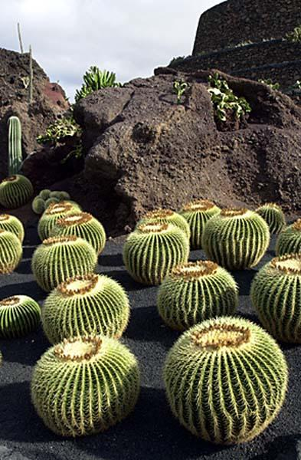
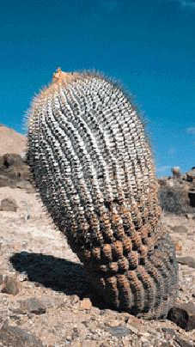
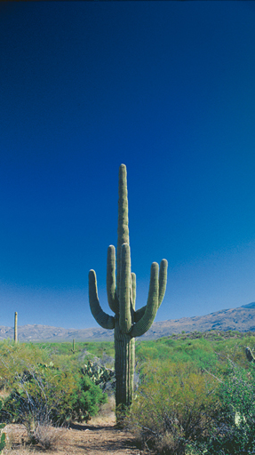
All Cacti are xerophytes

Slide 7
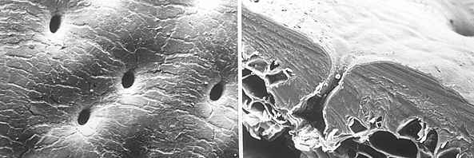
Left and right Epidermis of the cactus Rhipsalis dissimilis.
Left: View of the epidermis surface. The crater-shaped depressions with a guard cell each at their base can be seen.
Right: X-section through the epidermis & underlying tissues. The guard cells are countersunk, the cuticle is thickened. These are classic xerophyte adaptations.

Slide 8
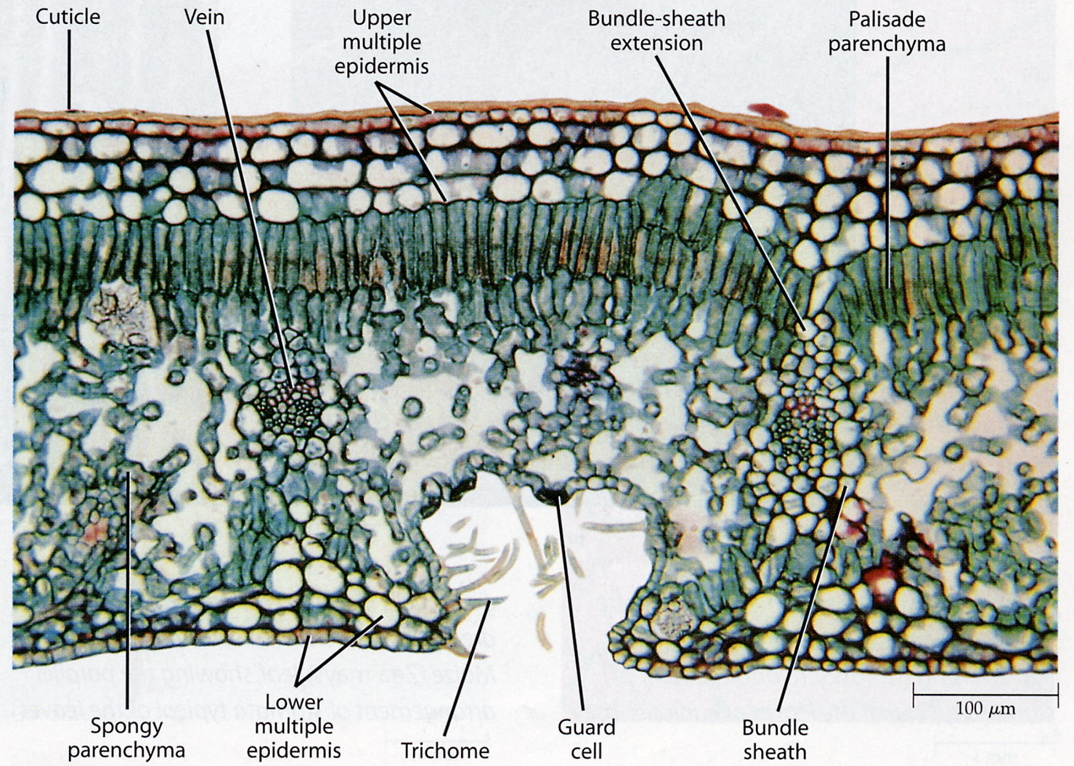
Transverse Section Through Leaf of Xerophytic Plant

Slide 9
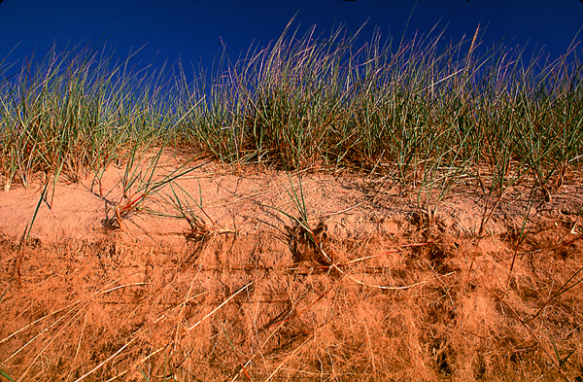

Slide 10
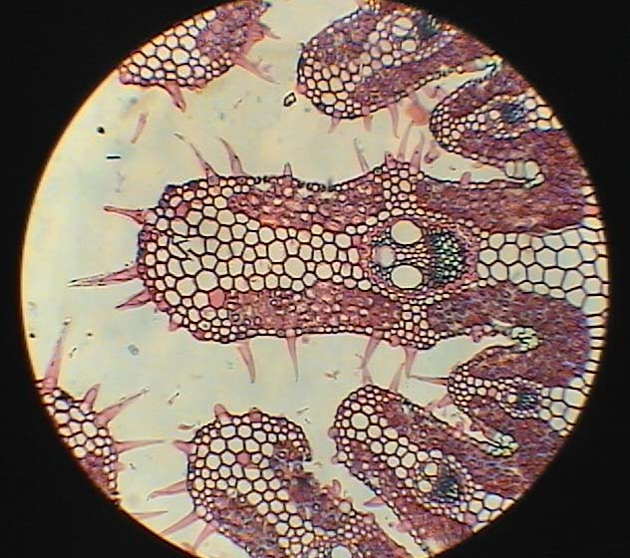
Internal Section view

Slide 11
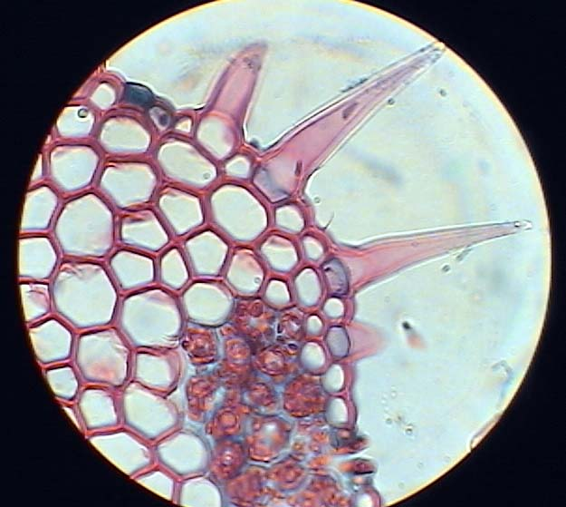
Internal Section view

Slide 12
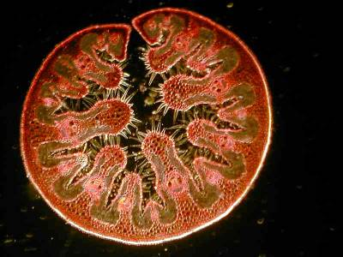
Internal Section view

Slide 13
Thank You

