Slide 1
Bentham and Hooker's classification (1862 – ’83)
George Bentham and Joseph Dalton Hooker - Two English taxonomists who were closely associated with the Royal Botanical Garden at Kew, England have given a detailed classification of plant kingdom, particularly the angiosperms.
They gave an outstanding system of classification of phanerogams in their Genera Plantarum which was published in three volumes between the years 1862 to 1883. It is a natural system of classification. However, it does not show the evolutionary relationship between different groups of plants, in the strict sense. Nevertheless, it is the most popular system of classification particularly for angiosperms. The popularity comes from the face that very clear key characters have been listed for each of the families. These key characters enable the students of taxonomy to easily identify and assign any angiosperm plant to its family.
Bentham and Hooker have grouped advanced, seed bearing plants into a major division called Phanerogamia. This division has been divided into three classes namely:
Dicotyledonae
Gymnospermae and
Monocotyledoneae

Slide 2
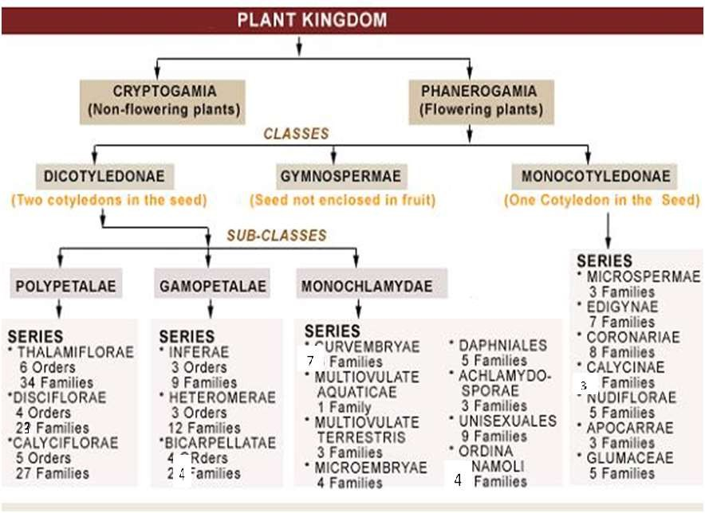
84
45
36
3
34

Slide 3
I. Sub-Class Polypetalae - The flowers are usually with two distinct whorls of perianth; the segments of the inner whorl or "corolla" are free.
Series-Thalamiflorae -(The calyx consists of usually distinct sepals, which are free from the ovary; doom shaped thalamus).
6 Orders/Cohort; 34 Families or Natural orders -R
Series – Disciflorae - The calyx consists of either distinct or united sepals, which may be free or adnate to the ovary; a prominent ring of cushion shaped disc is usually present below the ovary, sometimes broken up into glands; the stamens are usually definite in number, inserted upon, or at the outer or inner base of the disc; the ovary is superior.
4 Orders/Cohorts; 23 Families or Natural orders
Series – Calyciflorae - (Cup shaped thalamus; calyx consists of united sepals, rarely free and adnate to
the ovary; the petals are uni-or bi-seriate, and peri-or epi-gynous; the ovary is often inferior). 5 Orders/Cohorts; 27 Families or Natural orders –F,
II. Sub-Class Gamopetalae - (The flowers-are usually with two distinct whorls of perianth; the segments of the inner whorl or '.corolla' are fused).
Series – Inferae - (The ovary is inferior; the stamens are usually equal in number to the corolla lobes).
3 Orders/Cohorts; 9 Families or Natural orders-Ast
Series – Heteromerae - (The ovary is usually superior; stamens are epipetalous or free from the corolla, either equal to or double the number of petals, or indefinite; carpels are more than two in number).
3 Orders/Cohorts; 12 Families or Natural orders
Series - Bicarpellatae - (The ovary is usually superior; stamens are as many as or fewer than the corolla lobes, and alternating with them; carpels are two, rarely lesser or more ).
4 Orders/Cohorts; 24 Families or Natural orders S, Ve, La

Slide 4
III. Sub-class Monochlamydae - The flowers are with only one non-essential whorl (perianth) or absence of non-essential whorls. It includes 8 series.
Curvembryae: Usually single ovule, embryo coiled around the endosperm.
6 Families or Natural orders
Multiovulate Aquaticae: Aquatic plants with syncarpous ovary and many ovules. 1 Familie or Natural order
Multiovulate Terrestris: Terrestrial plants with syncarpous ovary and many ovules.
3 Families or Natural orders
Microembryae: Only one ovule, small, tiny embryo endospermic seed. 4 Families or Natural orders
Daphnales: Only one carpel and single ovule.
5 Families or Natural orders
Achlamydosporae: Ovary inferior, 1 to 3 ovules - unilocular. 3 Families or Natural orders
Unisexuales: Flower unisexual, perianth usually absent.
9 Families or Natural orders
Ordines Anomali: (Anomolous families) Plants with uncertain systematic position but closer to unisexuales.
9 Families or Natural orders

Slide 5
Class - Gymonspermae
3 Families or Natural Orders: (Gnetaceae , Coni ferae, and Cycadaceae)
Class -Monocotyledonae - One cotyledon, closed vascular bundles, parallel venation, trimerous flowers
Series -Microspermae - (The ovary is inferior; seeds are minute).
3 Families or Natural orders - Or
Series - Epigynae - (With very few exceptions, the ovary is inferior; seeds are large and with a
copious
endosperm).
7 Families or Natural orders
Series - Coronarieae - (The perianth, at least the inner whorl, is petaloid; the ovary is superior).
8 Families or Natural orders L
Series -Calycinae - (The perianth is sepaloid; the ovary is superior). 3 Families or Natural orders
Series - Nudiforae - (The perianth is usually absent or reduced to minute scales; seeds are albuminous).
5 Families or Natural orders
Series -Apocarpeae - (The perianth is absent or uni- or bi-seriate; the ovary is superior with one or more than one free carpels; seeds are exalbuminous).
3 Families or Natural orders
Series -Glumaceae - (The perianth is scaly or glumaceous or absent; the ovary is usually one-ovuled; seeds are albuminous).
5 Families or Natural orders - Poa

Slide 6
Merits
The obvious advantage of the system of Bentham and Hooker’s classification
is that, it provides one with easy means and ways for identifying a plant.
The description of families and genera is very accurate
Each family has a synopsis in the beginning which is very useful in identification
This classification is a great natural system of its own kind and to a great extent forms an ancestor of every recent system.
Another importance of this system lies in the extempore study of the actual specimens by the authors and thus the classification of Bentham and Hooker
represents the result of a careful comparative examination of known genera of all flowering plants.

Slide 7
Demerits
The classification is based on the assumption of constancy of species. It
establishes no phylogenetic relationship in different taxa of plants; hence many important evolutionary characters were neglected. So, closely related families were kept apart and many distant families of plants were put together e.g., in dicotyledons, Euphorbiaceae was placed in Monochlamydeae though related to
Malvaceae; the retention of some natural orders e:g. Nyctaginaceae, Polygonaceae, Amaranthaceae, Chenopodiaceae etc. in the subclass Monochlamydeae is also unnatural because those orders are related to the orders having differentiated perianth. Similarly in monocotyledons Hydrocharitaceae and highly evolved Orchidaceae were put together under Microspermae due to their small seeds. Related families like Liliaceae and Amaryllidaceae were kept apart.
The origin of angiosperms was not established.
The position of gymnosperms is also anomalous i.e. in between dicotyledons and monocotyledons.
The group Monochlamydeae is entirely artificial

Slide 8
Hutchinson's system of Classification
Hutchinson a British Botanist from England, associated with Royal Botanic Garden, Kew (1926,34) proposed a phylogenetic system of classification, its principles parallel to that of Bessey.
He mainly concerned with the classification of angiosperms. His work first appeared in a 2-volume work “The Families of Flowering Plants” (1926, 1934). This had undergone several revisions.
He published “Genera of Flowering Plants” (1964-1967).
He published “Evolution and Phylogeny of Flowering Plants” (1969).
According to him, angiosperms were considered monophyletic in origin, from hypothetical Proangiosperms. Initially , the angiosperms were regarded to have evolved along the two separate evolutionary lines, Herbaceae derived from Rannales and the Lignosae derived from Magnoliales.

Slide 9
Hutchinson's Classification was based on principles
Evolution is both (1) upwards and (2) downwards. The latter involving degradation and degeneration; examples: (1) towards the sympetalous condition; epigyny; (2) towards the. apetalous state of many flowers ; unisexuality in flowering plants.
Evolution does not necessarily involve all organs of the plant at the same time; and one organ or set of organ may be advancing while another set is stationary or retrograding. For example in the family Crassulaceae the carpels have remained free, while some genera aresympetalous.
Evolution has generally been consistent, and when a particular progression or retrogression has set in, it is persisted into the end of the' phylum; examples: the strong tendency to zygomorphy of the corolla coupled with the reduction in the number of stamens in Engler's hypogynous Metachlamydeae: the great tendency to perigyny and epigyny in the Archichlamydeae and Metachlamydeae as exhibited in the families Apiaceae and Rubiaceae respectively.
In certain groups, trees and shrubs are probably more primitive than herbs; examples: Mimosaceae and Caesalpiniaceae (trees and shrubs) as compared with the derived family Fabaceae (papiJionaceae) (becoming herbaceous).

Slide 10
Trees and shrubs are older than climbers, the latter habit having been acquired through particular environment.
Perennials are older than biennials, and from them annuals bave been derived; note the extraordinarily few annuals in the primitive family Ranunculaceae and in Rosaceae; the great number in the more advanced and natural family Brassicaceae.
Aquatic phanerogams are as a rule more recent than terrestrial (at any rate in the members of the same family or genus), and the same may be said of epiphytes and parasites.
8 Plants with collateral vascular bundles arranged in a cyclic manner (Dicotyledons) are more primitive in origin than those with scattered bundles (Monocotyledons), though It does not necessarily follow that the latter have been directly derived from the former.
The spiral arrangement of leaves on the stem and of the floral leaves
precedes that of the opposite and whorled type.
As a rule simple leaves precede compound leaves.
Bisexual (hermaphrodite) precede unisexual flowers, and the dioecious is probably more recent than the monoecious condition.
The solitary flower is more primitive than the inflorescence, the highest forms of the latter being the umbel and capitulum ; examples of the latter: Apiaceae and Asteraceae respectively.

Slide 11
Spirally imbricate floral parts are more primitive than whorled and valvate ;
examples: Magnolia and Clematis.
Many-parted flowers (polymerous) precede, and the type with few parts (oligomerous) follows from it, being accompanied by a progressive sterilisation of reproductive parts (sporophylls); examples: Magnolia and Cherianthus.
Petaliferous flowers precede apetalous ones, the latter being the result of
reduction.
Free petals (polypetaly) are more primitive than connate petals (sympetaly).
Actinomorphy (regularity) of the flower is an earIier type than zygomorphy (irregularity) ; examples: Caltha and Delphinium.
Hypogyny is the primitive structure, and from it perigyny and epigyny were
derived later.
19 Free carpels (apocarpy) are more primitive and from them connate carpels resulted; sometimes however, when the carpels have remained loosely united during evolution they may again become quite free, especially in fruit; example: Asclepiadaceae.
Many carpels (polycarpy) precede few carpels (oligocarpy); examples:
Ranuncu/us and Nigela.
The endospermic seed with small embryo is primitive and the non- endospermic seed more recent; examples: Ranunculaceae and Rosaceae.

Slide 12
In primitive flowers there are many stamens, in more advanced flowers few stamens; examples: Ranunculus and Cherianthus. This condition may, however, be reversed within the confined of a single family like Papaveraceae, where bees feed on the pollen .
Separate stamens precede connate stamens; examples: Tiliaceae and Malvaceae ; Campanulaceae and Lobeliaceae
Aggregate fruits (fruits formed from several separate flowers) are more recent than single fruits, and as a rule the capsule precedes the drupe or berry

Slide 13
Summary of Hutchinson's classification (1926, 34) and (1959-60)
Introduction:
Hutchinson, a British Botanist from England, associated with Royal Botanic Garden, Kew (1926,34) proposed a phylogenetic system of classification, whose principles were parallel to that of Bessey.
He mainly concerned with the classification of angiosperms. His work first appeared in a 2-volume work “The Families of Flowering Plants” (1926, 1934). This had undergone several revisions.
He published “Genera of Flowering Plants” (1964-1967).
He published “Evolution and Phylogeny of Flowering Plants” (1969).
According to him, angiosperms were considered monophyletic in origin, from hypothetical Proangiosperms. Initially , the angiosperms were regarded to have evolved along the two separate evolutionary lines, Herbaceae derived from Rannales and the Lignosae derived from Magnoliales.

Slide 14
Hutchinson, in his earlier classification (1926, 34), classified the entire group of
Flowering plants into two phyla, namely, Gymnospermae and Angiospemae.
I. Gymnospermae was nearly considered as a linear monophyletic series in an
ascending order from the Cycadaceae → Ginkgoaceae → Taxaceae
→ Pinaceae → Cupressaceae
He agreed that the Araucarieae "may have been formed independently.“
II. Hypothetical Pro-angiosperms → phylum Angiospermae.
Angiospermae was divided into two sub-phyla, the Dicotyledones and the
Monocotyledones.
In his earlier edition of 'The Families of Flowering Plants," (1926,34), Hutchinson divided the Dicotyledones into two divisions, namely, Archichlamydeae and Metachlamydeae, on the basis of the polypetalous and gamopetalous conditions of flowers respectively.
On the other hand, the sub-phylum the Monocotyledones was divided into three divisions, namely, Calyciferae ,Corolliferae and Glumiflorae.

Slide 15
Hutchinson in his revised classification (1959- 60) follows:
divided Angiospemae as
II. Hypothetical Pro-angiosperms → phylum Angiospermae. (last revision 1973)
Hypothetical Proangiosperms (Bennettitales-like ancestors) gave rise to Dicotyledons. Initially, the angiosperms were regarded to have evolved along two separate evolutionary lines, Lignosaeand Herbaceae, later the Monocotyledons originated from early herbaceous dicots like Ranales – so a monophyletic origin of angiosperms is suggested in this classification.
Dicotyledonae was divided into two distinct subgroups viz. subgroup 'Lignosae'
and subgroup 'Herbaceae' , according to priority of evolution.
The 'Lignosae' includes families whose members are fundamentally and
predominantly
woody trees, -54 orders, beginning with Magnoliales and
ending with Verbenales, 246 fam
Herbaceae includes families whose members are fundamentally and predominantly herbaceous. 28 orders, beginning with Ranales and ending with Lamiales, 97 fam
the sub-phylum the Monocotyledonaederived from Ranales, was divided into three divisions, namely, Calyciferae ,Corolliferae and Glumiflorae depending on the nature of parianth. These have evolved from herbaceae. 29 orders, 69 fam

Slide 16
Merits
The origin of angiosperms is considered monophyletically from hypothetical Proangiosperms which had Bennettitalean characters.
It is a phylogenetic system in which he has contributed a real work by his careful and critical estimate in the limitations of families and orders.
The principles upon which the classification is based provide an indication of current trend in phyletic thinking. In the phylogenetic tree, Hutchinson did not derive one order directly from the other but from its ancestral stock.
The arrangement of families within the-monocotyledons has been
particularly appreciated the world over.
It has provided a sound basis for the later phylogenetic system by Oswald, Tippo, Cronquist, Takhtajan and others. His long association with the
flowering plants and herbarium are very well
his critical observations in the field as well as in the projected in his sound judgements which
were primarily based on external morphological features but later
supported by investigators in other related fields

Slide 17
Demerits
The main disadvantage of the classification lies in the undue fragmentation of
families.
In his revised classification, creation of two phyletic lines e.g. Lignosae (woody arboreal) and Herbaceae (herbaceous) is thought by many botanists to be a defect reflecting the old Aristotalean view. Overall resemblances and critical anatomical studies of Bailey, Sinnott, and others lead to assume that herbaceous habit has been derived from woody habit again and again and the reverse has also occurred occasionally. The two evolutionary lines therefore, cannot be considered distinct. Further, this primary division has resulted into wide separation of some families which resemble one another rather closely on the basis of floral structure. Various herbaceous families in the Ranales are clearly related to woody members of Magnoliales; herbaceous Umbelliferae are more closely related to and probably derived from the woody Cornaceae and Araliaceae; herbaceous Cruciferae are clearly derived from the predominantly woody Capparidaceae most probably via Cleomaceae; several other herbaceous families like Lythraceae, Onagraceae~ his Gentianales, Primulales, Saxifragales, Personales and Lamiales are more closely related to the woody Myrtales, his Apocynales, Myrsinales, Rosales and Verbenales respectively rather than among themselves. In spite of severe criticism from many parts of the world.

Slide 18
The origin of angiosperms from Bennettitalean-like ancestry is criticised by some workers (Bailey), as the anatomical structures of the early dicots are not tenable with such ancestry.
In the establishment of new taxa, Hutchinson however did not put any adequate remarks, as a result relative groups are shown to be distantly related and small taxa are delimited on resemblances only.

Slide 19
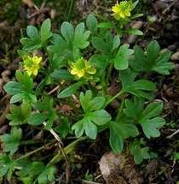
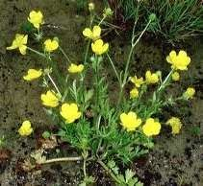
Ranunculaceae

Slide 20
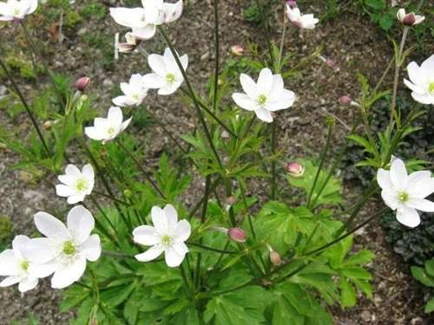
Around 50 genera , 1800 species

Slide 21
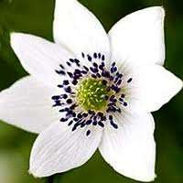
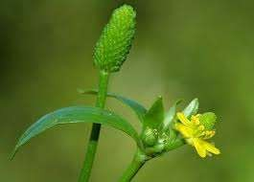
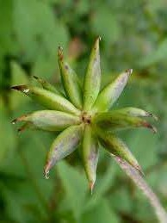

Slide 22
Economic importance
Medicininal : Aconitum heterophyllum- aconitina- relieve pain and palpitation
Thalictrum foliosum – drug for opthalmia and other eye problems
Anemone pulsatilla – pulsatilla - tonic for nerves problem Ornamental: Ranunculus, Clematis, Delphinium
Spices: Nigella sativa (black cumin) seeds are used as condiment and
spice
  Affinity
Affinity and relationship with families Berberidaceae, Magnoliaceae etc of dicots and Alismaceae, Hydrocharitaceae of monocots
  Primitive characters of the family

Slide 23
systematic position
Bentham and Hooker’s
Class – Dicotyledonae Sub-Class Polypetalae Series-Thalamiflorae Order- Ranales
Natural Order (Family)-Ranunculaceae
Hutchinson’s
Sub-phylum– Dicotyledonae Sub-group- Herbaceae Order- Ranales
Family- Ranunculaceae

Slide 24
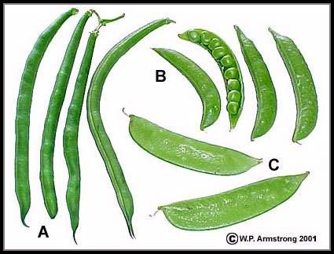
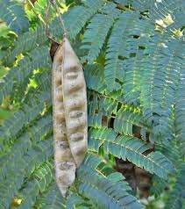
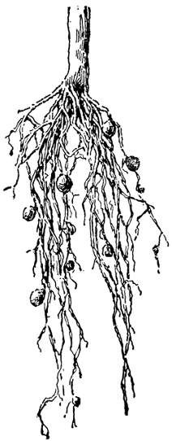
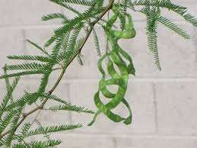
Fabaceae
750 genera, 17000 species

Slide 25
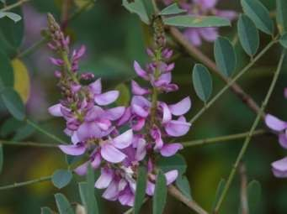
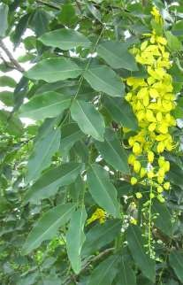
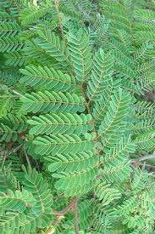
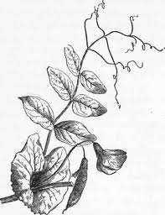
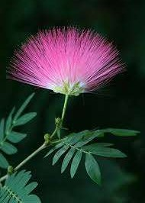
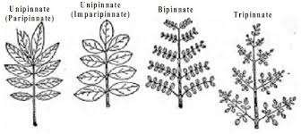

Slide 26

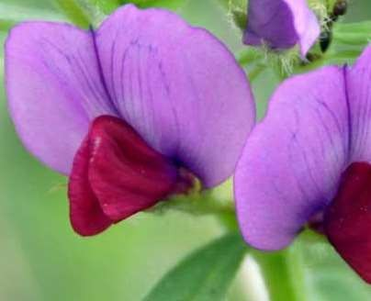
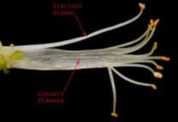
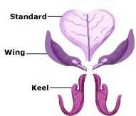


482 genera
7200 species

Slide 27
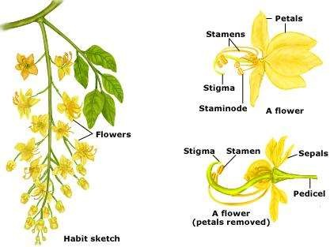
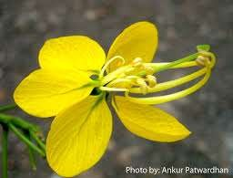
180 genera
2800 species

Slide 28
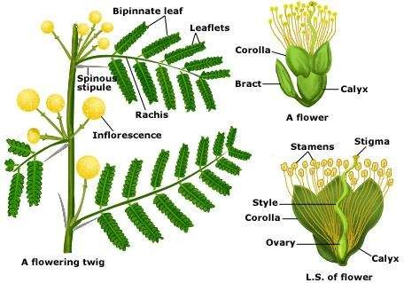
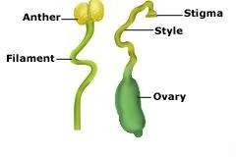

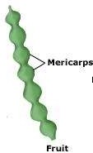
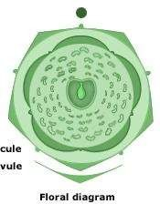
56 genera
2800 species
lomentum

Slide 29
Economic importance- Albezia lebbeck-timber, Pisum sativum, Phaseolus spp, Cicer spp,
Indigofera tinctoria yield indigo
Affinity related to family Rosaceae
systematic position
Class – Dicotyledonae Sub-Class Polypetalae Series-Calyciflorae Order- Rosales
Family- Fabaceae/Leguminosae

Slide 30

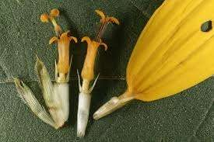
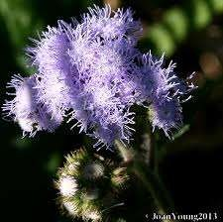
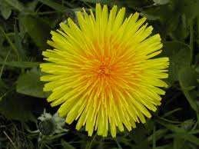

Asteraceae

Slide 31
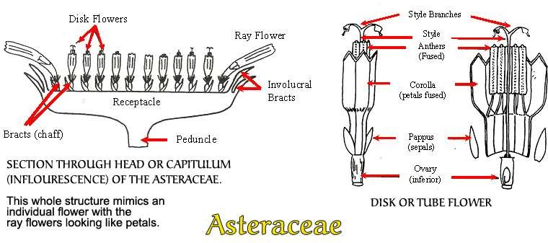
1100 genera, 25000 species

Slide 32
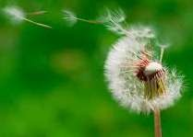
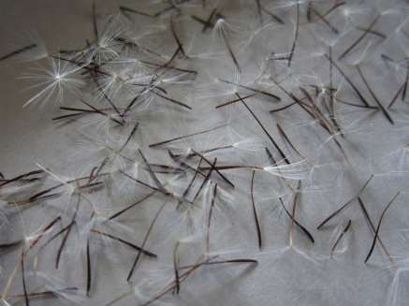

Slide 33
Economic importance
Medicininal : Artemissia absinthium , A. maritima – santonine (drug)
Arnica montana – arnica medicine
Ornamental:
Edible:
Affinity and systematic position
The family has got affinity with the members of the order Rubiales.
Class – Dicotyledonae
Sub-Class Gamopetalae Series-Inferae
Order- Asterales
Family- Asteraceae/Compositae
Advanced characters of the family
largest number, herbaceous, pappus, syngenecious stamens, epigyny, fruit possess pappus parachute

Slide 34
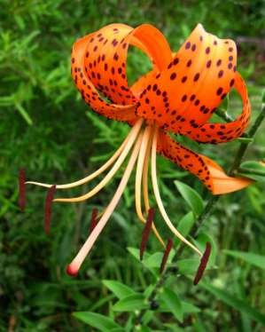
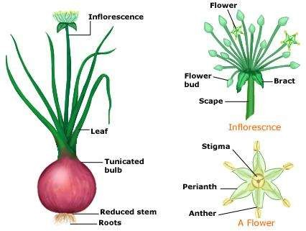
240 genera, 4,000 spp
Liliaceae
Lilium lancifolium

Slide 35
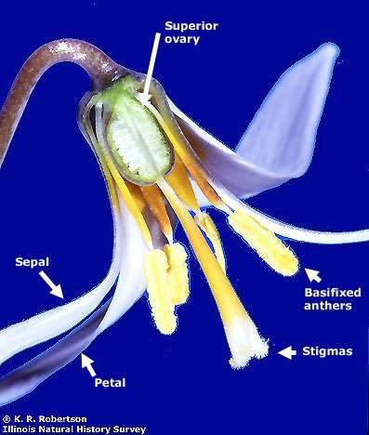
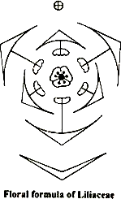

Slide 36
Economic importance
Medicininal uses: Aloe barbadensis, Alium sativum, are used as medicine.
Ornamental : Lilium lancifolium, Yucca s, Tuli
Vegetables, condiments and Spices: Alium sativum, Alium cepa, Alium hookerii etc.
Affinity and systematic position
The family is closely related to Amaryllidaceae, Juncaceae, Pontederiaceae and Commelinaceae
Class – Monocotyledonae Series- Coronarieae Family- Liliaceae

Slide 37
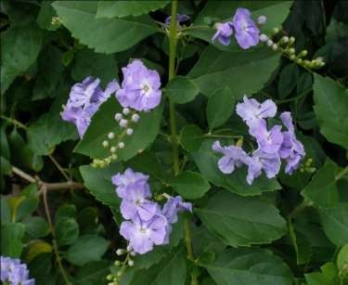
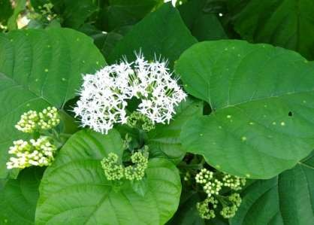
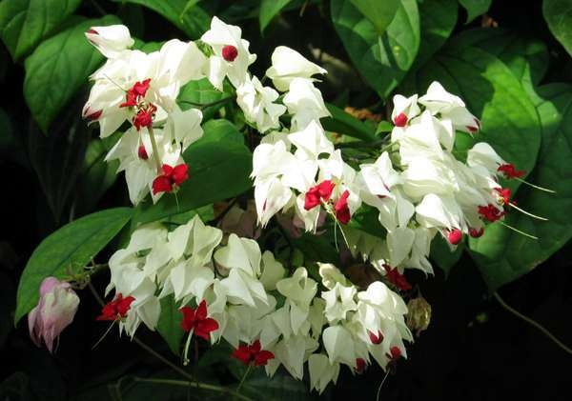
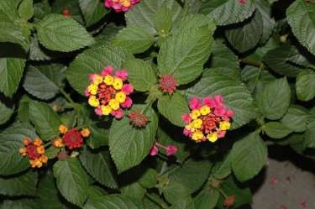
Verbenaceae
Clerodendrum colebrokianum
80 genera, 800 species
Clerodendrum thomsoniae

Slide 38
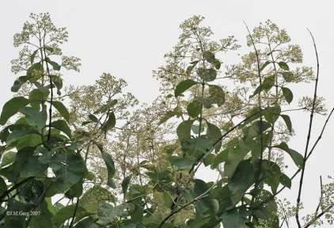
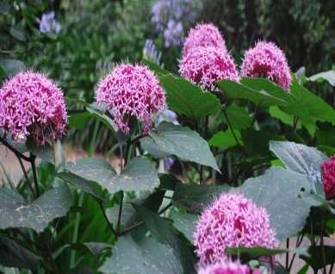
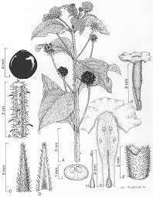
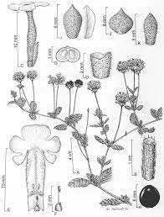
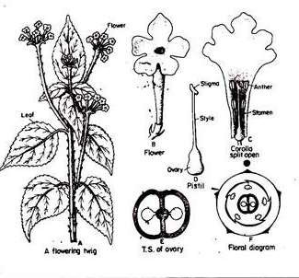

Slide 39
Economic importance
Timber : Tectona grandis, Gmelina arborea
Medicinal: young leaves and shoots of Clerodendrum colebrokianum are boiled and used as medicine to reduce blood pressure.
Ornamental: Duranta repens, Clerodendrum indicum, Clerodendrum thomsoniae
Edible: young leaves of Clerodendrum colebrokianum are used as vegetables Affinity and systematic position
The family closely resembles Labiatae
Class – Dicotyledonae Sub-Class Gamopetalae Series-Bicarpellatae Order- Lamiales
Family- Verbenaceae

Slide 40
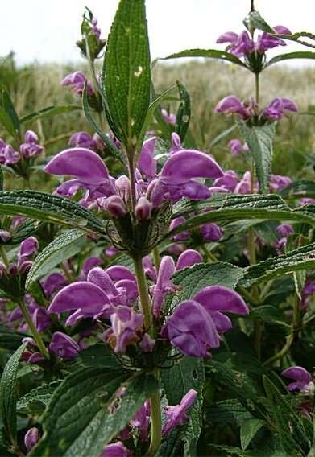
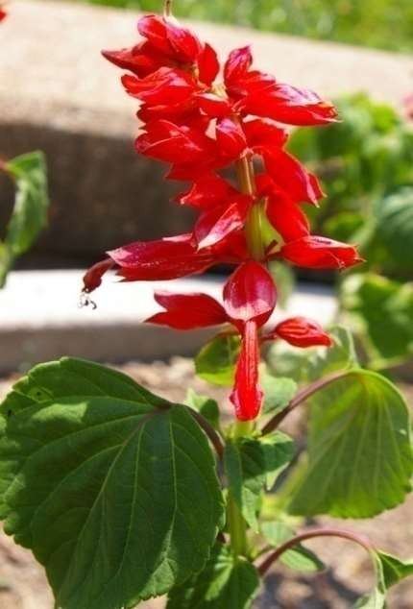
Lamiaceae
200 genera, 3200 species

Slide 41
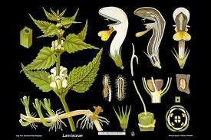

Slide 42
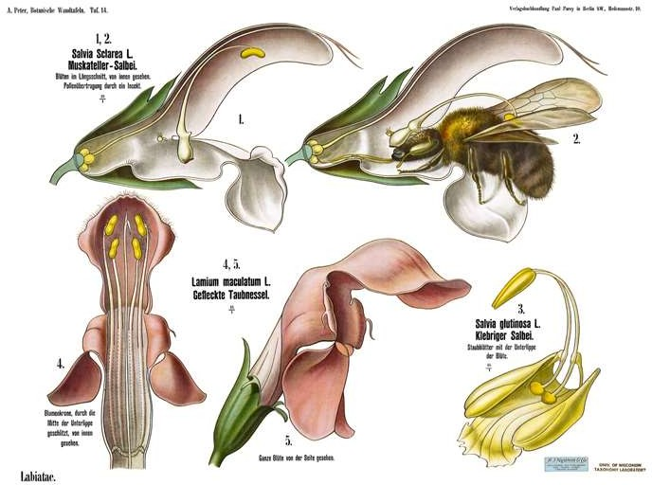


Slide 43
Economic importance
Medicininal : leaves and flowering tops of Rosemarinus offiicinalis yields oil of rosemary,
used in perfumery and medicine. It also ha antibacterial property
Mentha piperata is the source of peppermint oil used in pharmacy, confectionery and for flavouring.
Ocimum sanctum yields essential oil which is used in medicine and perfumery.
Ornamental: S. Splendens, Coleus sp Meriandra bengalensis etc are grown as ornamental plants.
Edible: Mentha piperata
Affinity and systematic position
The family is closely related to Verbenaceae and Boraginaceae
Class – Dicotyledonae Sub-Class Gamopetalae Series-Bicarpellatae Order- Lamiales
Family- Labiatae/Lamiaceae

Slide 44
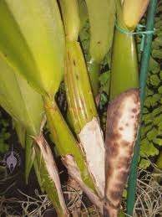


Orchidaceae

Slide 45
750, genera, 18000 spp

Slide 46


Slide 47




Slide 48
Economic importance
Medicininal : Vanda roxburghii – roots are used for rheumatism and scorpion sting
Ornamental: Dendrobium spp, Cymbidium spp etc
Edible: Vanila planifolia, - dried pulpy fruits yield vanilla – a scent for flavouring chocolate and confectionary.
A blue dye is obtained from the leaves of Calanthe veratriflora.
Affinity and systematic position
The family is closely related to Musaceae, Zingiberaceae and Liliaceae
Class – Monocotyledonae Series- Microspermae Family- Orchidaceae
The most advanced family among monocots
  Zygomorphic with modifications – labellum, for insect pollination
  Epiphytic habit
  Aerial roots
  Pseudobulbs
  Epigyny
  Gynostegium
  Rostellum ensures cross pollination
  Pollination mechanism has reached the highest specialisation in the development
of pollinia.

Slide 49





650, genera, 9000 spp
poaceae

Slide 50


Slide 51



Slide 52
Economic importance
Medicininal grasses: Phragmites karka Trin is used in medicine
Cereals and millets: Triticum sativum, Zea mays, Oryza sativa etc.
Fodder grasses
Sugar yielding: Saccharum oficinarum.
Building materials: Bambusa sp, Dendro-calamus spp.
Aromatic grasses: Citronella sp (lemon grass), Cymbopogon spp
Affinity and systematic position
The family is closely related to Cyperaceae and Juncaceae
Class – Monocotyledonae
Series- Glumaceae
Family- Gramineae/Poaceae

Slide 53




47 genera, 1150 spp
Zingiberaceae

Slide 54

Figure 1. Hedychium deceptum N. E. Br.
Intact single flower.
Bract.
Bracteole.
Corolla tube with calyx and ovary.
Dissected calyx.
Dorsal and lateral corolla lobes.
Labellum.
Lateral staminodes.
I. Stamen.
Anther, ventral and dorsal views.
Ovary with epigynous glands and basal portion of style.
Ovary in cross section.
Upper portion of style with stigma.

Slide 55




Carpels with stylodial glands

Slide 56
Economic importance
Medicininal uses: Curcuma zedoaria is used in medicine, rhizome of Costus speciosus is
uses as medicine.
Ornamental : Hedychium coronarium.
Spices: Zingiber officinalis, Curcuma longa
Affinity and systematic position (Hutchinson’s classification) The family is closely related to Musaceae
Sub phyllum – Monocotyledones Division - Caliciferae
Order – Zingiberales
Family - Zingiberaceae

Slide 57





Solanaceae
Solanum lycopersicum var. cerasiforme
Lycopersicon esculentum var. cerasiforme
Cyphomandra betacea/ Solanum bataceum
90 genera, 2200 spp

Slide 58





Petunia axillaris
Capsicum baccatum

Slide 59








Slide 60
Economic importance
Medicininal : Atropa belladona for atropin, which is used in tinctures and plasters, it is also antidote for poisoning by opium.
Datura atrsmonium – dried leaves are the sources of drug stramonium, used in spasm of broncioles in asthma and treatment in parkinsonism.
Ornamental: Petunia axillaris
Edible:
Affinity and systematic position
The family has got affinity with the members of Convolvulaceae and Scrophulariaceae.
Class – Dicotyledonae Sub-Class Gamopetalae Series-Bicarpellatae Order- Polemoniales Family- Solanaceae

