Slide 1
Systematics
G. Swapna
Lecturer in Botany

Slide 2
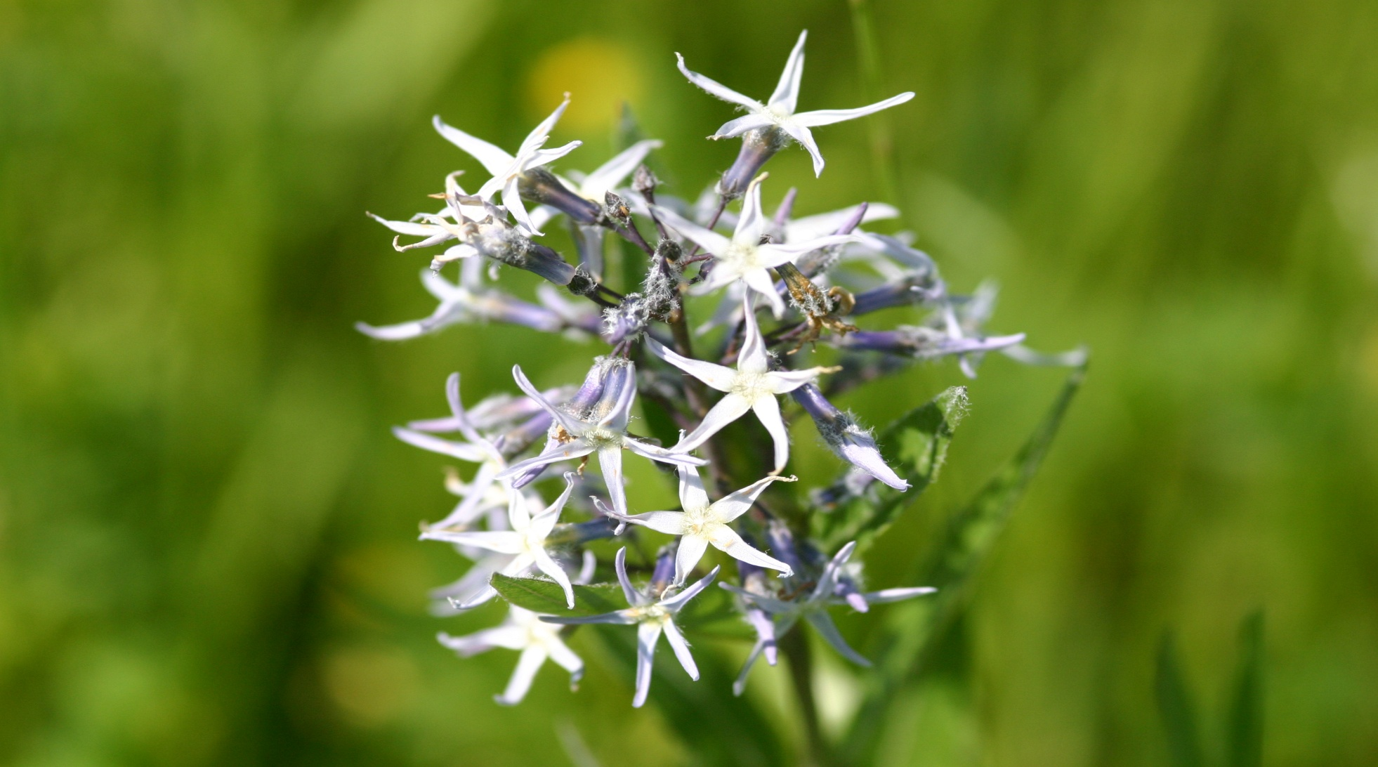
Systematics

Slide 3
Taxonomy-
Classification-
Identification or Determination-
Nomenclature-

Slide 4
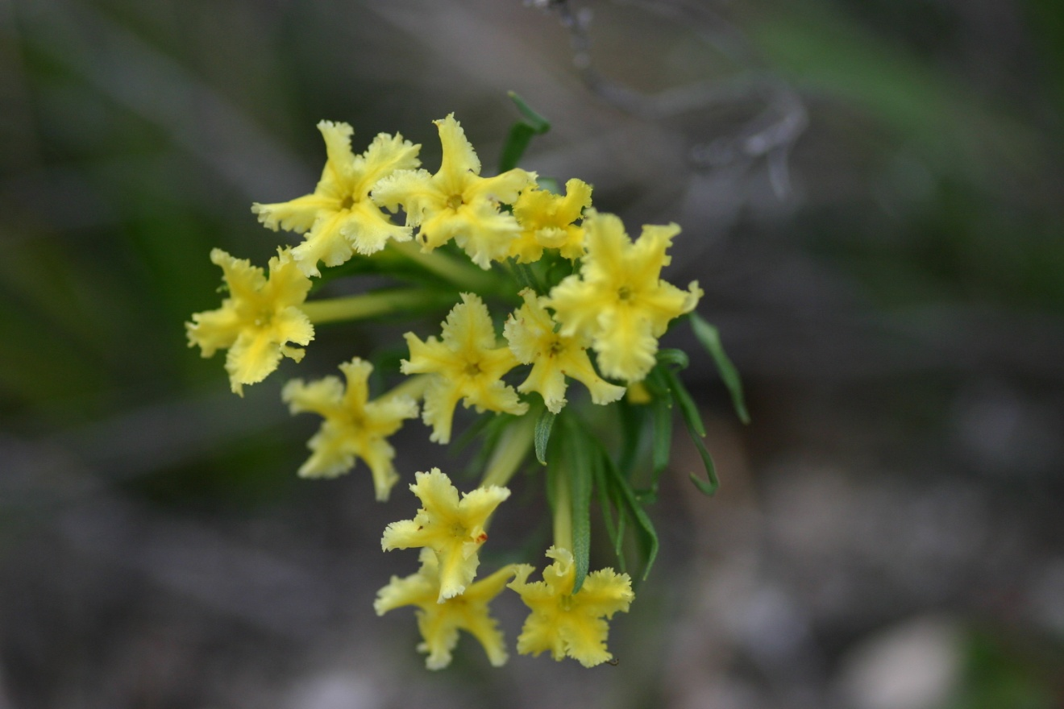
Floristics-
Examples: Manual of the Vascular Plants of Texas
Shinners and Mahler’s Illustrated Flora of North
Central Texas
Flora of North America

Slide 5
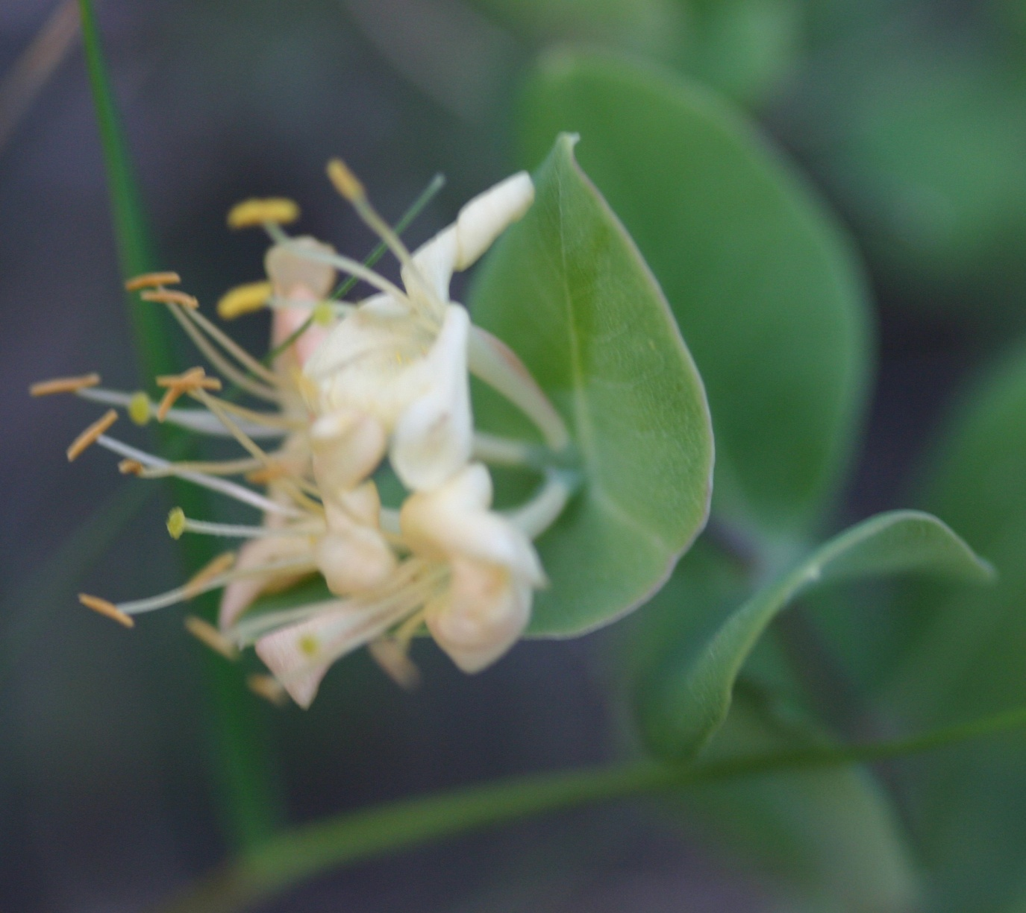
Native-
Introduced or exotic-
Naturalized-
Lonicera albiflora
Torr. & Gray
and L. sempervirens L.
(red) are only native
honeysuckles in our
area. Three are
perfoliate, whereas
introduced species
are not.

Slide 6
Primary goals of plant systematics:
Identify and describe all plants of world
@_____ species of plants known. Many more undiscovered
(15,000 new species in South America alone).
@_____ vascular plants in USA and Canada
@_____ in Texas and 2223 in North Central Texas
Develop a uniform, practical, and stable system of naming
plants that can be used by both plant taxonomists and others
needing to communicate about plants
International codes providesrules for naming and classification
that is uniform and stable. Books and websites allow us to
communicate (Appendix 5
and 11)
3. Form groups that reflect their evolutionary relationships

Slide 7
Taxa are grouped according to two main schools of
taxonomists (Read Appendix 6 for details):
1. Traditional taxonomists
-
-look at overall similarity or phenetics which may recognize
paraphyletic groups like Asclepiadaceae and Reptiles (Fig. 39
And 40)
-Cronquist System in Appendix 1 is a widely used traditional
classification and uses monophyletic and paraphyletic groups

Slide 8
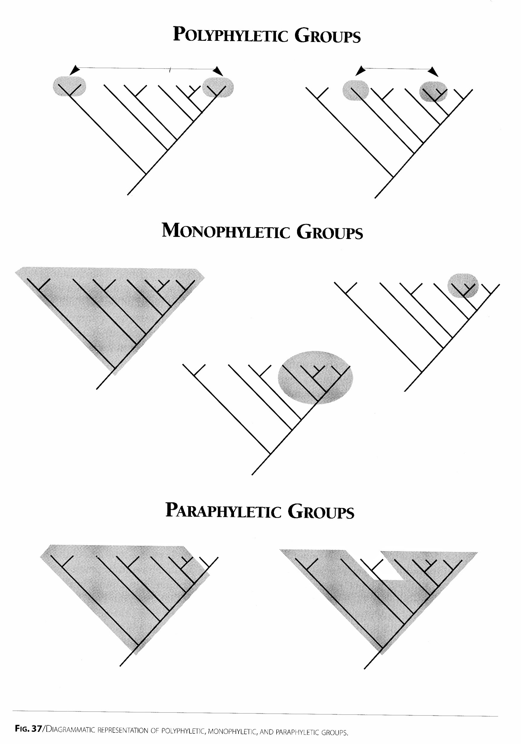

Slide 9
Monophyletic group-
-groups taxonomists try to form
-give information that is critical for breeding programs and
search for useful products
Paraphyletic group-
-accepted by traditional taxonomist when group is phenetically
different and can be identified by its morphology ex. Birds and
Asclepidaceae.
Polyphyletic group-
-taxonomist has made a mistake due to convergent evolution where species are not genetically closely related but have
adapted to similar environments

Slide 10
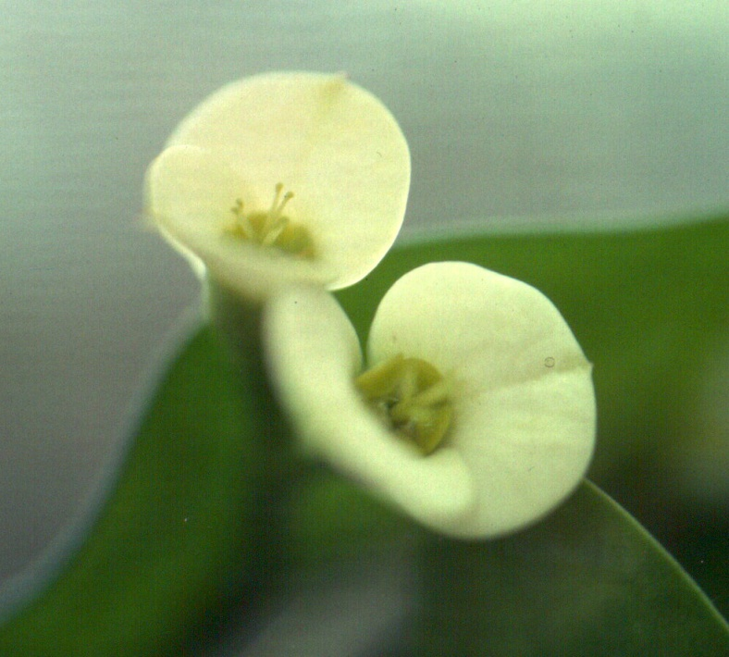
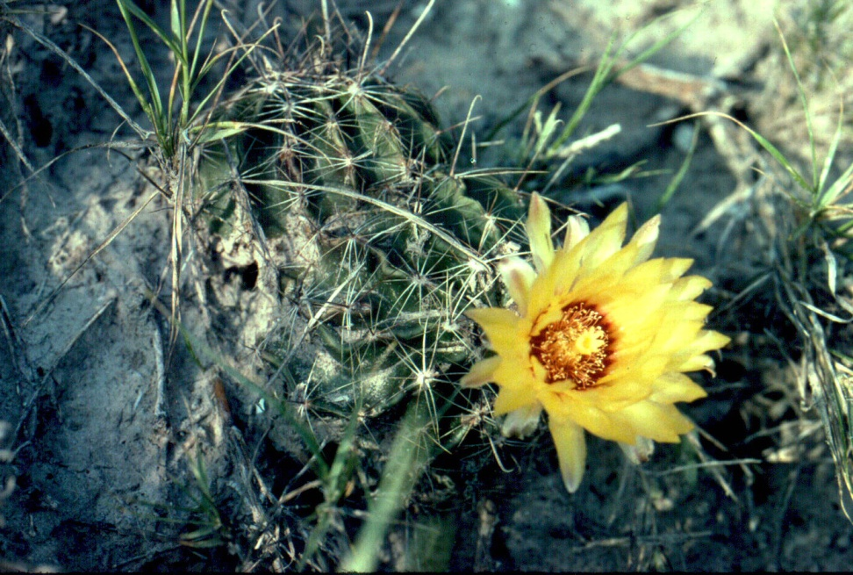
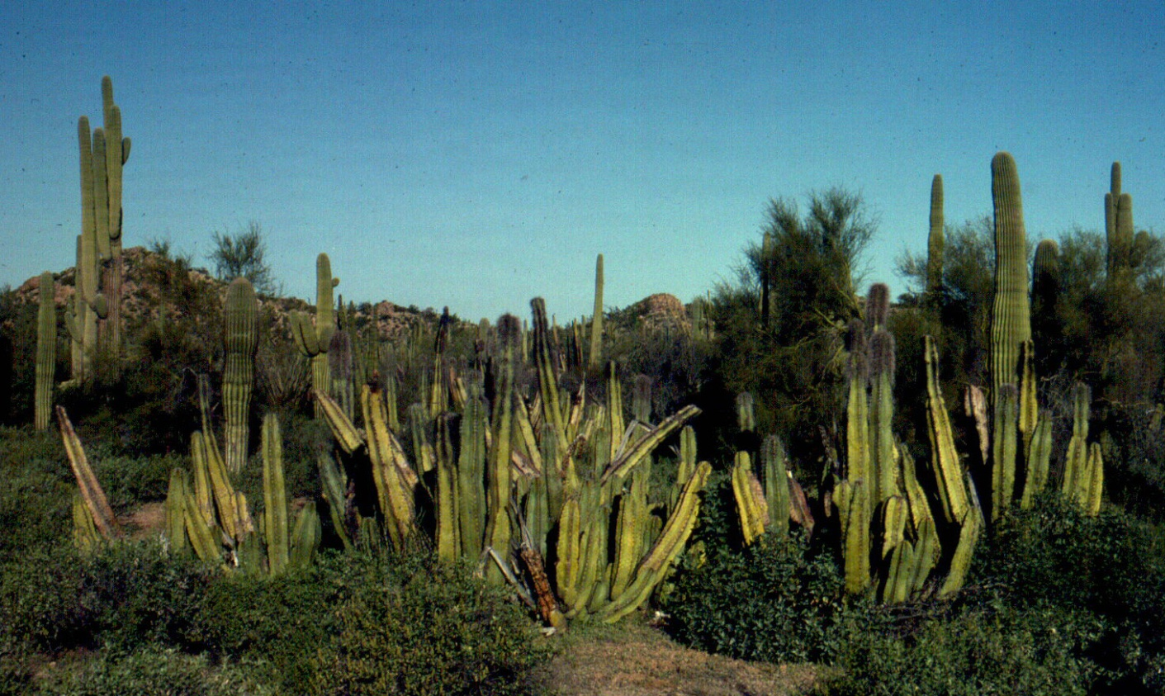
Classic example of
convergence in
plants:
Euphorbiaceae &
Cactaceae

Slide 11
Cladists or phylogenetic classification
-does not use binomial nomenclature or ranks
-only examines the branching patterns of evolution using
phylogenetic trees that reflect monophyletic groups
-only recognizes monophyletic groups, so Asclepiadaceae
becomes part of Apocynaceae and birds part of Reptilia (Figs. 39
and 40)
-cladogram using DNA sequence data indicates that monocots
are derived from within dicots making the dicot group
paraphyletic (Fig. 41)

Slide 12
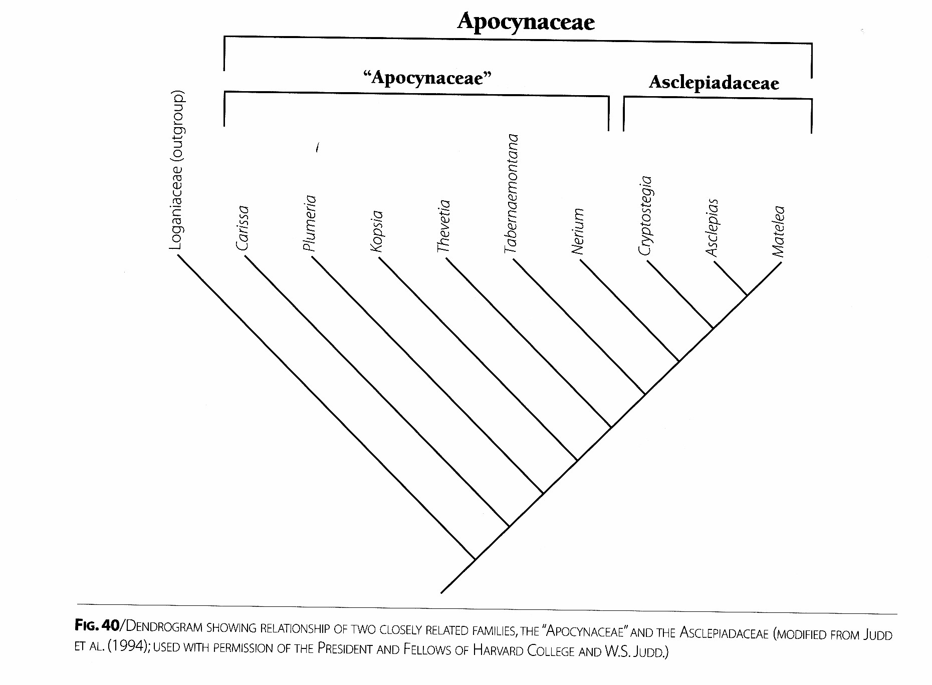

Slide 13
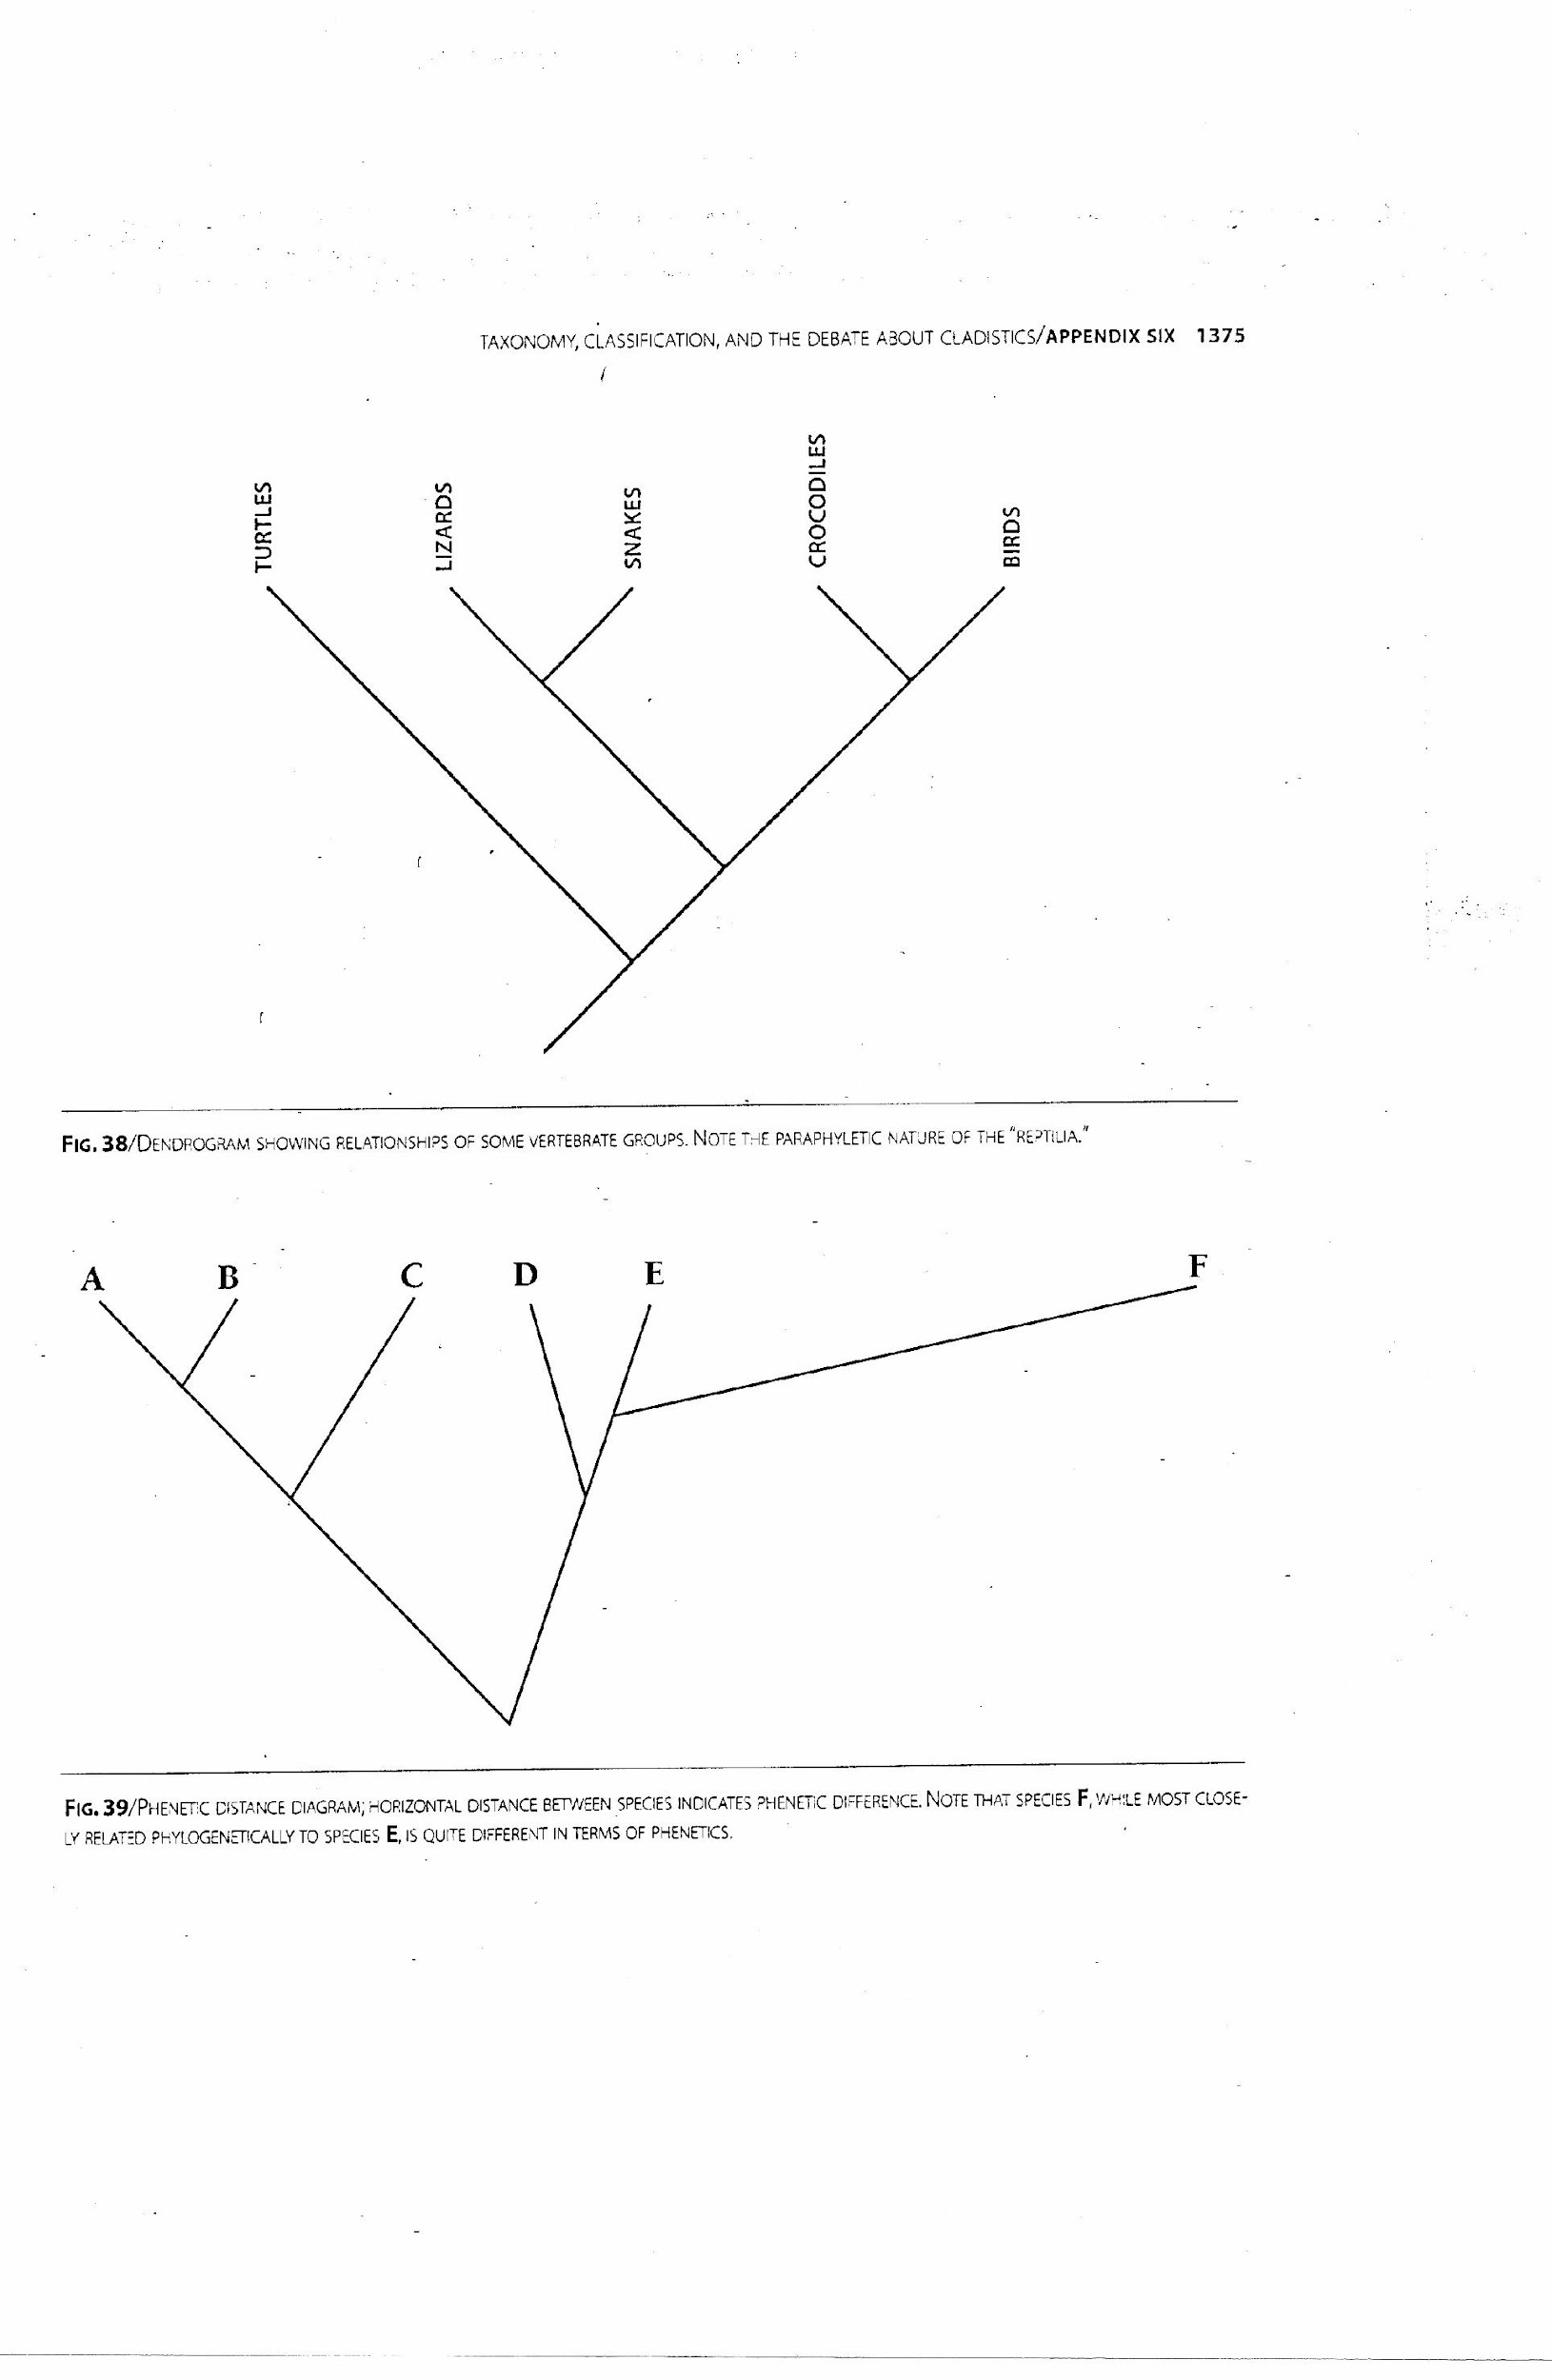

Slide 14
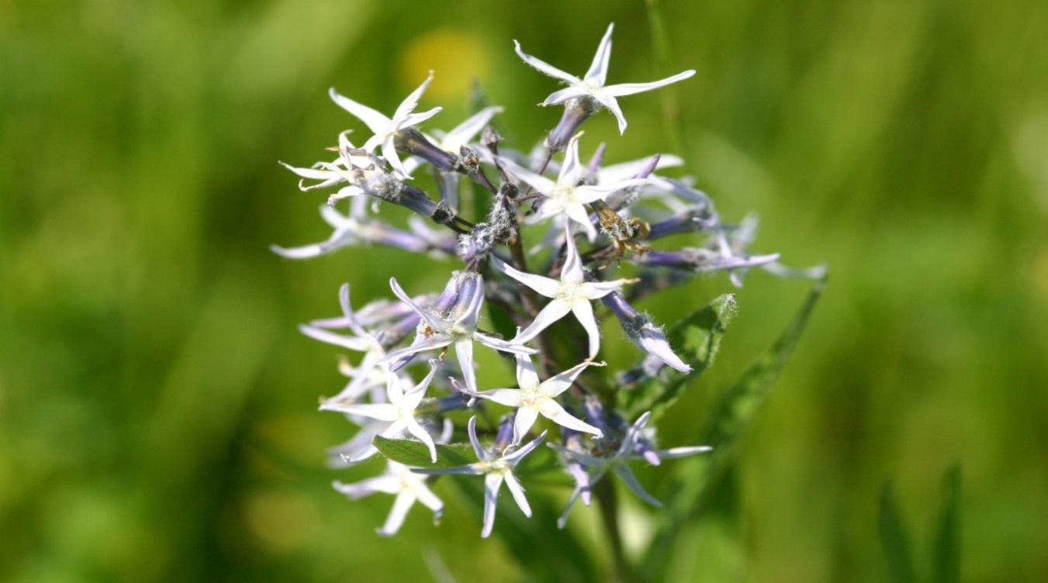
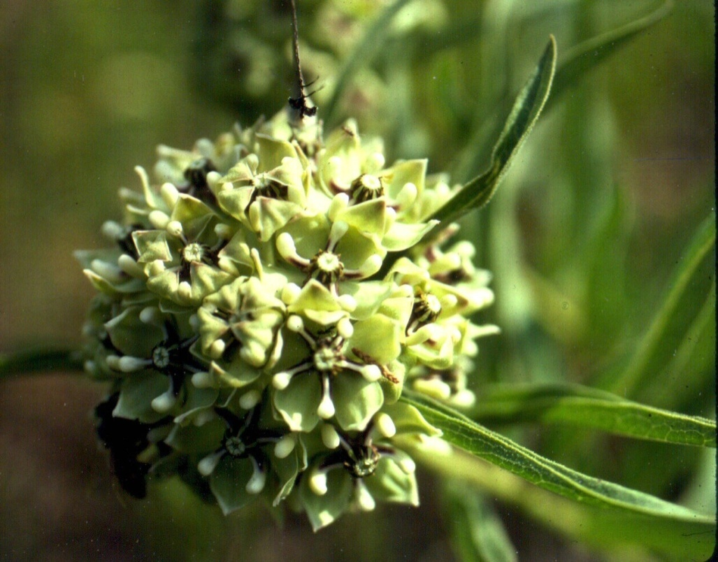
Apocynaceae
(1900 species)
Amsonia ciliata Walter
Asclepiadaceae
(2900 species with
characteristics of
Apocynaceae except all
have corona and fused
stamens and pistil)
Asclepias viridiflora Raf.

Slide 15
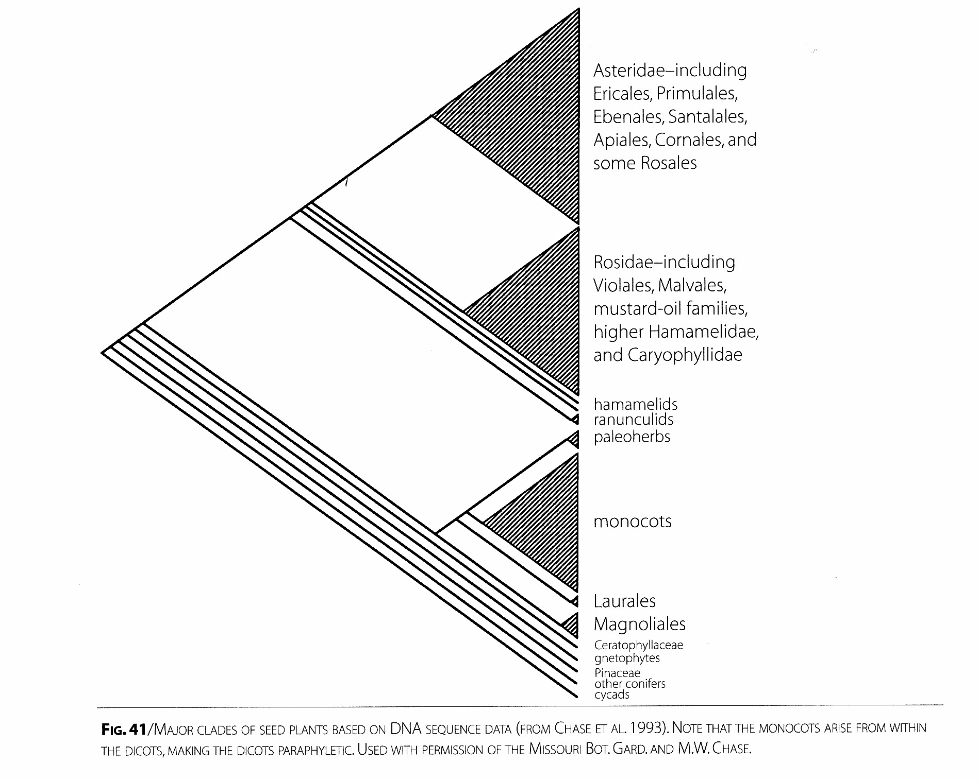

Slide 16
After grouping is complete, ranks are assigned.
Ranks used in the Taxonomic Hierarchy
_______________________
-plants have eukaryotic cells and are in Domain Eukaryota
Kingdom
-members of the Kingdom Plantae, photosynthesize, have tissues,
and undergo alternation of generations.
_______________________
-groups of classes
-international rules specify that it must end in -phyta
Bryophyta, Anthoceratophyta, Marchantiophyta (Hepatophyta),
Lycopodiophyta, Psilotophyta, Equisetophyta, Polypodiophyta,
Cycadophyta, Ginkgophyta, Pinophyta, Gnetophyta, and
Magnoliophyta are the 12 divisions of plants

Slide 17
_____________________
-groups of subclasses and orders
-international rules specify an -opsida ending
-Magnoliopsida (Dicots) and Liliopsida (monocots) are the two
classes of Magnoliophtes (Anthophytes or Angiosperms)
Subclass
-groups of orders that end in -idea
-Cronquist system contains 11 subclasses and is widely used and presented in Appendix 1
Order
-groups of families that end in -ales

Slide 18
____________________
-groups of subfamilies, tribes, or genera that end in -aceae
-387-685 depending on classification system with 149 in North
Central Texas
Eight families may have endings other than -aceae:
Name Modern Name Common Name
Palmae Palm
Cruciferae Mustard
Umbelliferae Carrot
Labiatae Mint
Graminae Grass
Leguminosae Pea
Compositae Sunflower
Guttiferae Clusiaceae St. John’s Wort

Slide 19
Subfamily
-groups of tribes or genera in large families that ends in -oideae
-One example is the Grass family in Appendix 2
Tribe
-groups of genera in large families that end in -eae
-One example is the Grass family in Appendix 2 and Asteraceae on Page 298
Genus (Genera)
-groups of one (monotypic Ex. Ginkgo biloba) to several species
(large one is Quercus (oaks) with 400 species worldwide)
-first part of binomial scientific name with no set ending
-may be divided into sections or subgenera in a large genus

Slide 20
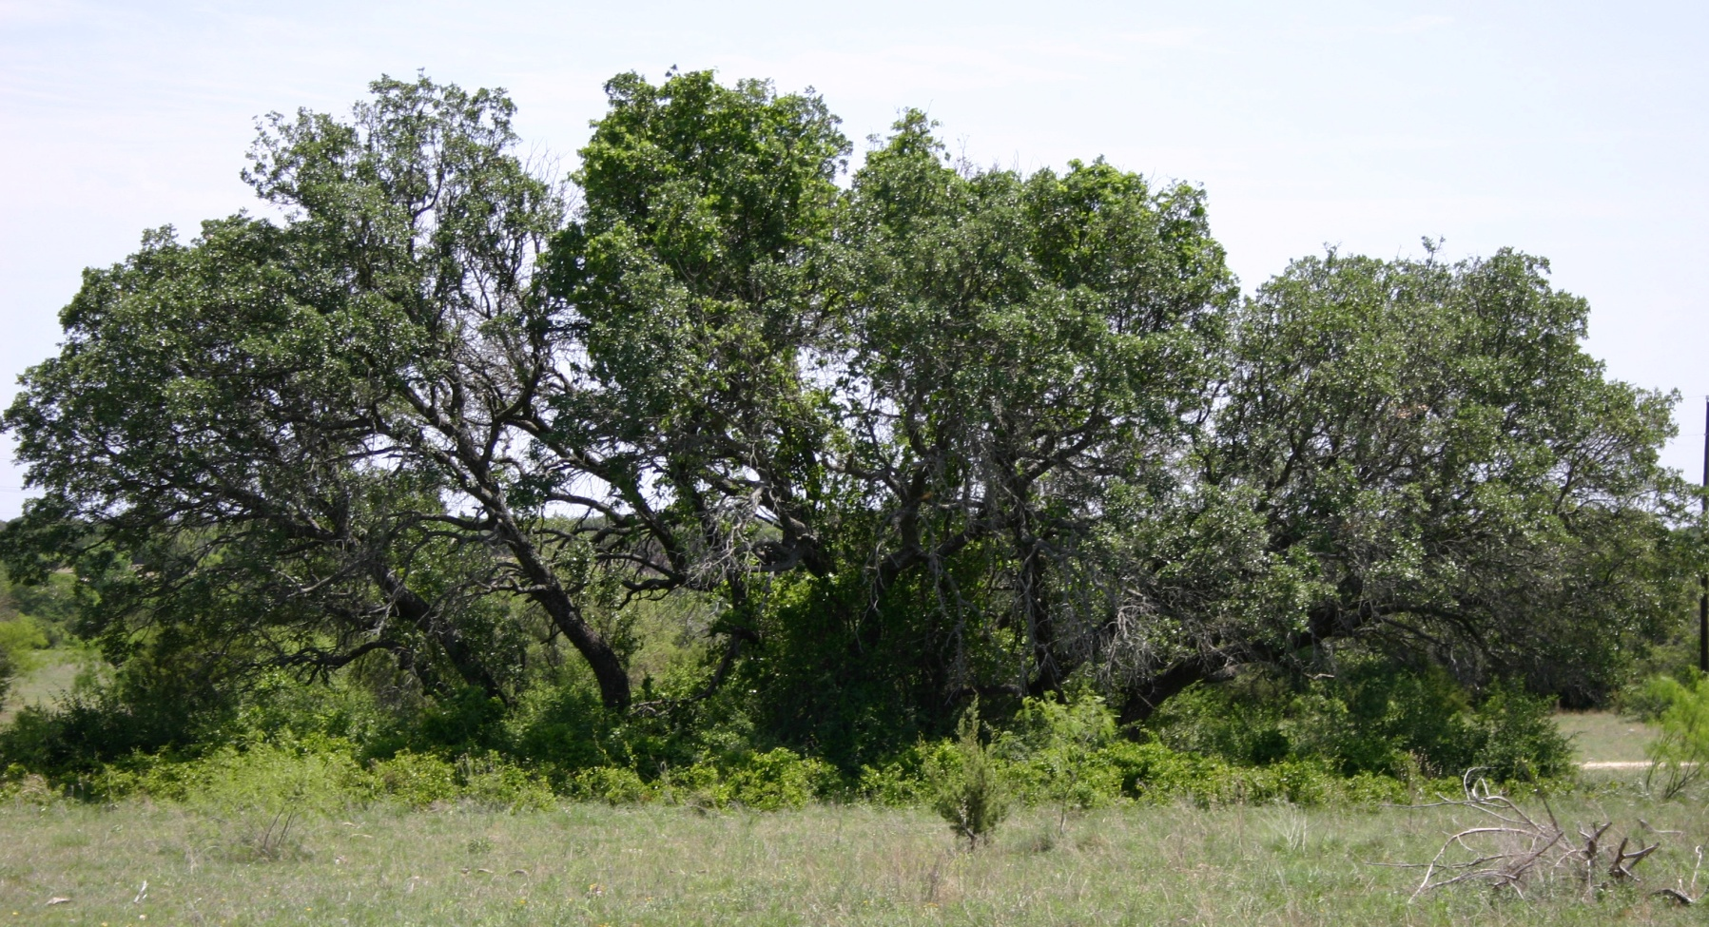
Species
-the second part of a binomial scientific name often called the
species epithet with no set ending; basic unit of classification
-may not be used alone as must accompany a genus name. When
the genus name is written once in a document, it may be
abbreviated-Q. fusiformis Small (liveoak)

Slide 21
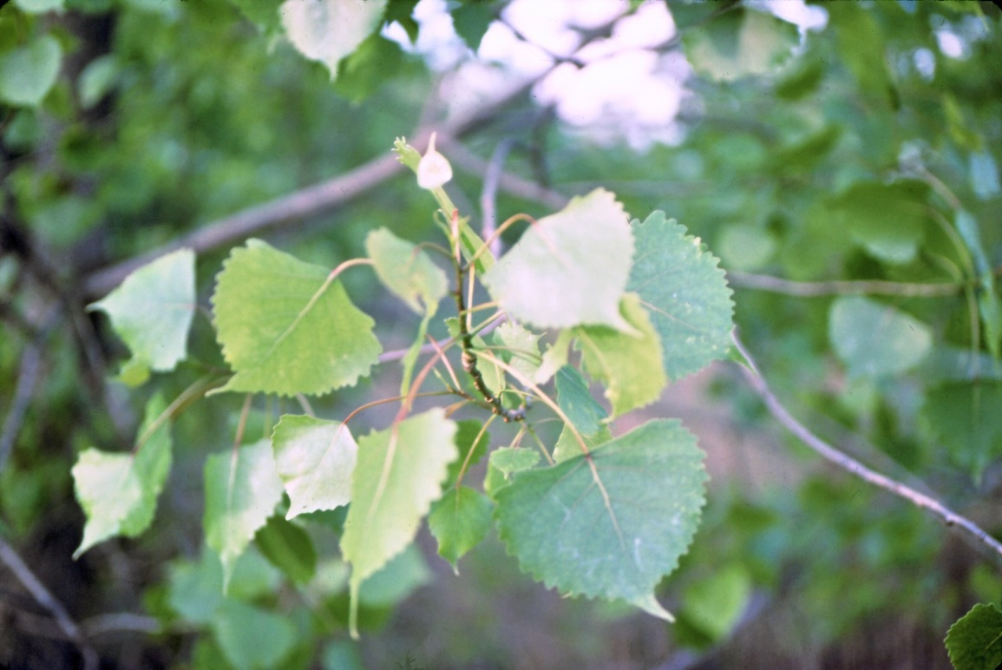
Why use scientific names instead of common names?
Common names are not____________, scientific names are.
Common names give no information about generic relationships
For example cottonwoods and aspens are both close relatives and
in the same genus, Populus. You may have known these common
names but not realized they were related.
Plants often have more than one _____________name.
Populus deltoides Bartram ex
Marshall subsp. deltoides is
called eastern cottonwood and
alamo.

Slide 22
Several plants may have the same common name. For
example 100s of different plants are referred to as sunflowers
Many plants do not have a common name. Cyperus setigerus Torr. & Hook
Common names may be ______________. For example live oak and poison-oak are in two very different families.

Slide 23
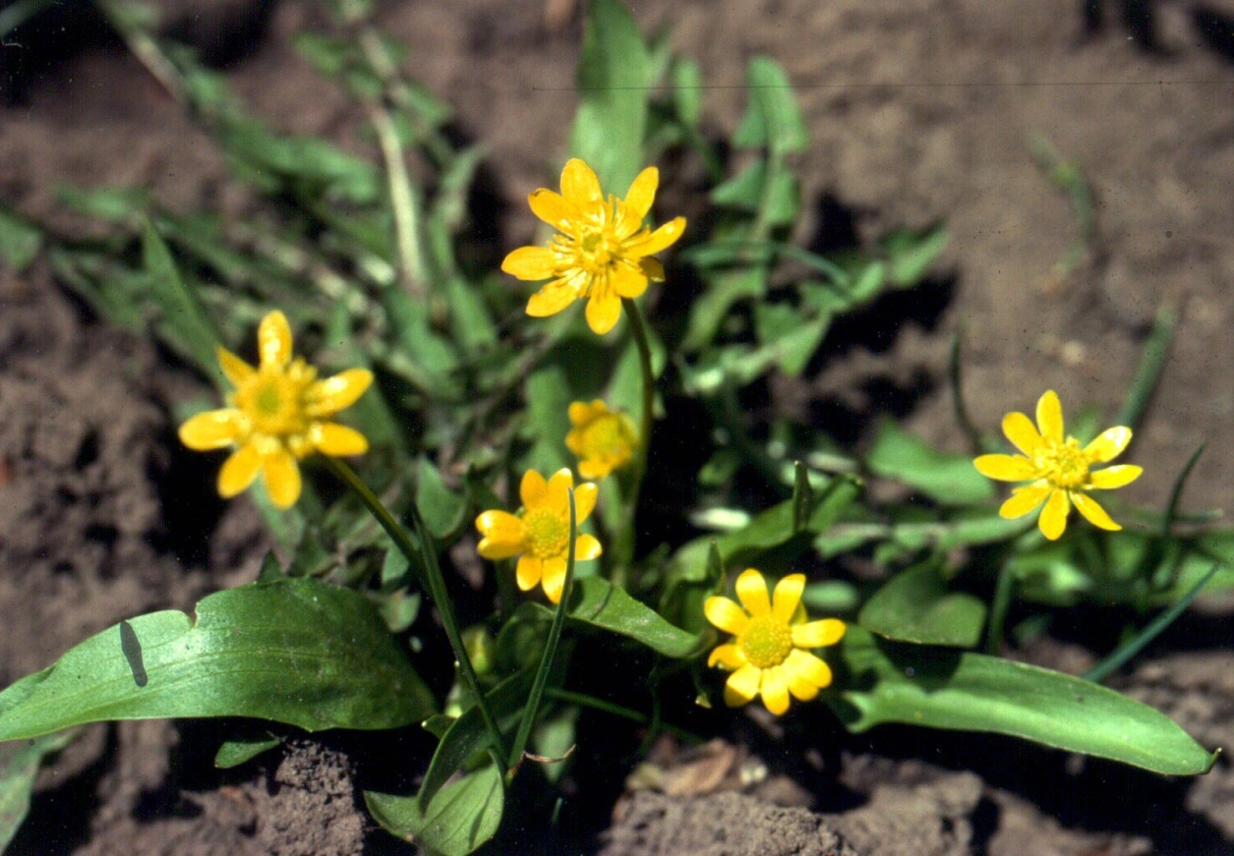
Scientific or botanical names were originally polynomials that were
a brief description of the plant in Latin. These were eventually all
changed to binomial nomenclature by Linnaeus. For example, one species of buttercup was called Ranunculus calycibus retroflexis, pedunculis falcatis, caule erecto, foliis compositis which means the buttercup with bent-back sepals, curved flower stalks, erect stems, and compound leaves

Slide 24
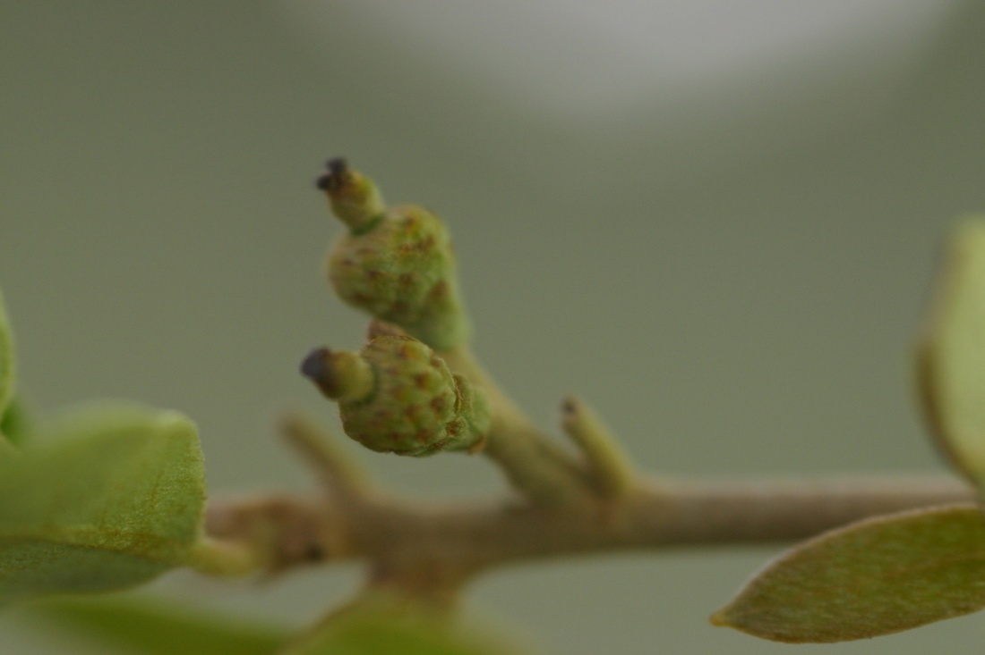
Complete Scientific Name consists of three parts:
Generic name-Latin name beginning with a capital letter that is
italicized or underlined; if species is unknown can substitute sp.
(singular) or spp. (plural). Uninomial- Quercus sp.
2) Specific name or species epithet-Latin name beginning with a
lowercase letter that is italicized or underlined that is always used
with a genus name. Binomial- Q. fusiformis (liveoak)
3) Authority-indicates the scientist that named a particular taxon.
Never italicized or underlined and often abbreviated- Q. fusiformis
Small

Slide 25
Three intraspecific or infraspecific taxa are trinomials
1) Subspecies-populations within a species that have a regional range with distinctive morphological characteristics
-only intraspecific taxon used by zoologists and favored by modern plant systematists
Example: Populus deltoides Bartram ex Marshall (cottonwood)
P. deltoides subsp. deltoides
-leaf blade 10-20 teeth on each side, E. 1/2 Texas to Wichita Falls
P. deltoides subsp. monilifera (Aiton) Eckenw.
-leaf blade with 5-10 teeth on each side, Panhandle S & E to Eastland County in our area
Pg. 975-977 SMIFNCT

Slide 26
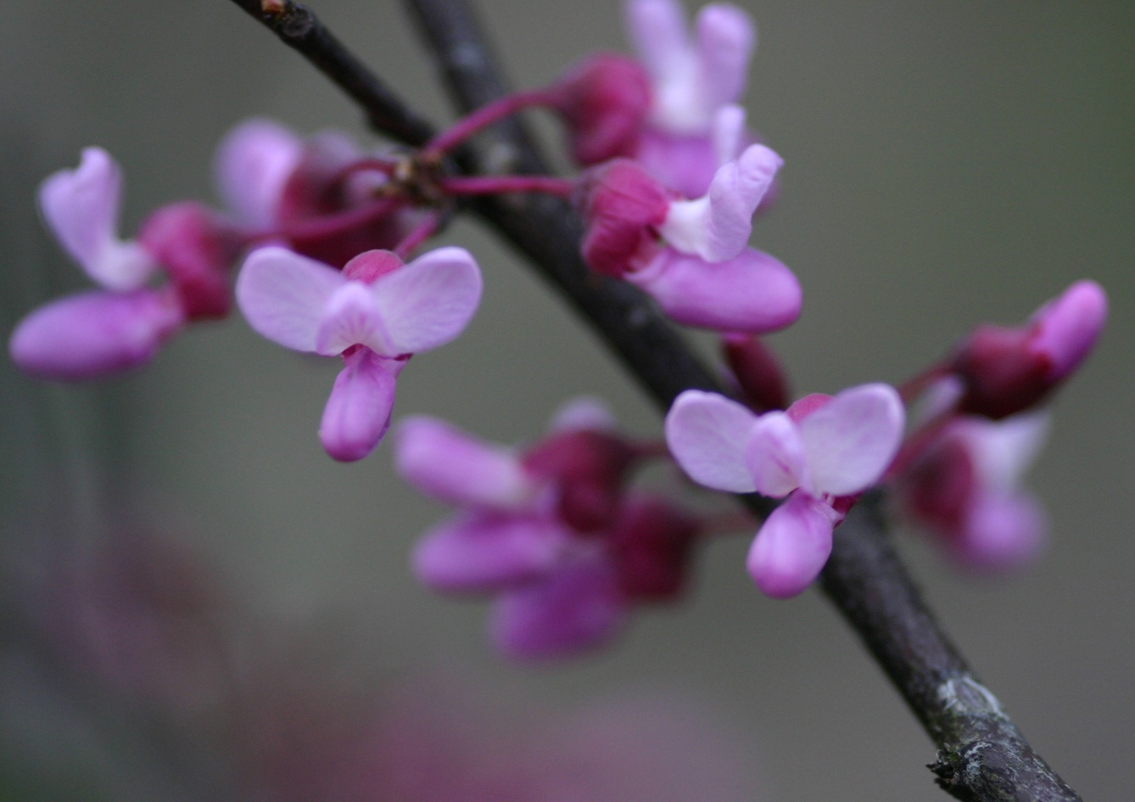
2) Variety-populations within a species or subspecies with minor
morphological variation and a local range
-sometimes varieties are treated in the same sense as subspecies
Example: Cercis canadensis L. var. canadensis (usually single
trunked, etc. (Pg. 640) in stream bottoms and lower slopes in sand
or silt) and C. canadensis L. var. texensis (S. Watson) M. Hopkins
(usually multi-trunked, etc. on rocky limestone slopes)

Slide 27
3) forma-lowest category in the taxonomic hierarchy that is
differentiated by minor variation.
-rarely used today and is not used in SMIFNCT
Miscellaneous Names:
Cultivars-cultivated form of some native species distinguished
by any characteristics and propagated by any means
-not a taxonomic category, used in horticulture
-not governed by international codes botanical nomenclature but by rules
of cultivated plants
-written with an initial capital letter and uses a modern language
-indicated by cv. or single quotation marks Ex. Citrus limon cv.
Sugardaddy or C. limon ‘Sugardaddy’

Slide 28
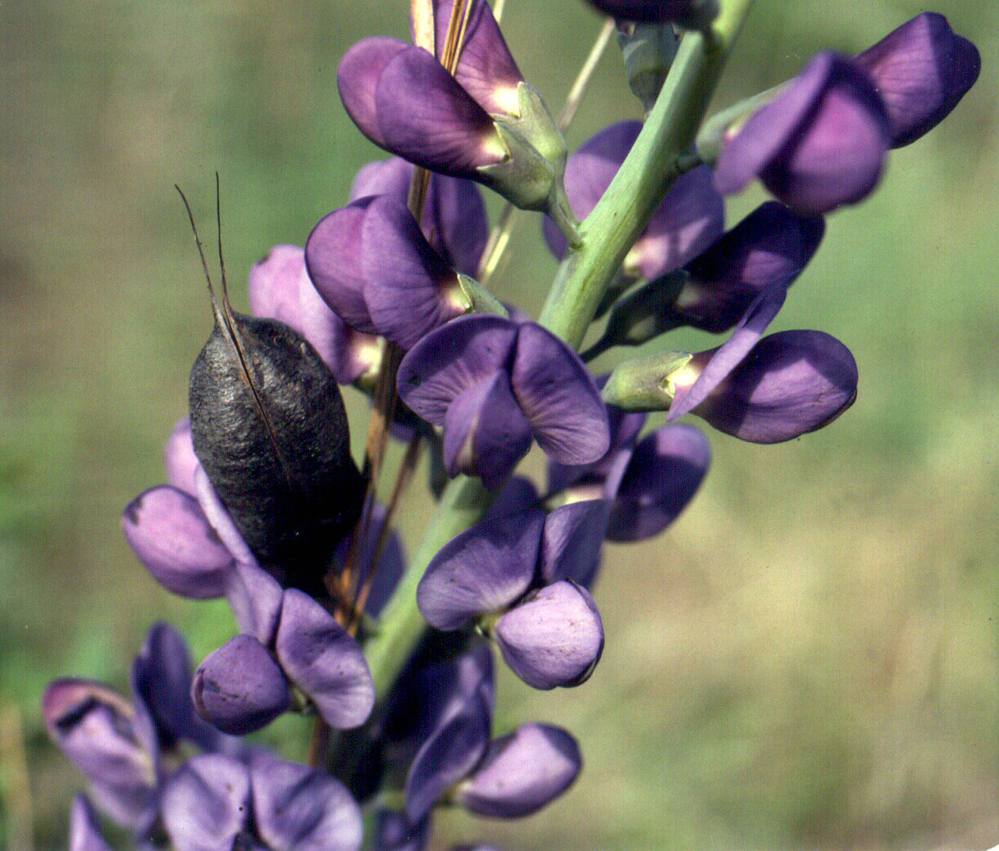
2) Hybrids-parental names connected by an X or an X in front of a
collective name
Example Baptisia Xbicolor Greenm. & Larisey [B. australis X
B. bracteata] Pg. 80 SMIFNCT
B. australis

Slide 29
International Code of Botanical Nomenclature (ICBN) is now
IC of Nomenclature for algae, fungi, and plants (ICNAFP)
Names follow rules of international codes, which include six principles:
Botanical nomenclature is independent of zoological
nomenclature. Names used in classification may overlap.
Botanical names are represented by types. Types are
specimens designated by botanist that names a new species.
They legally represent the name of the species and provide the
original material used in its description.
Each taxonomic group has only one name.
Scientific names are treated in Latin. International Code of Botanical
Nomenclature was revised and Latin is no longer required.

Slide 30
ICNAFP principles (cont.):
Nomenclature is based on priority of publication.
-way to determine acceptance when there are two or more names
for the same taxon
-oldest validly published name is correct starting with Species
Plantarum, a book written by Linnaeus in 1753, and working your
way forward through the literature
Two consequences of principle of priority-
1. Double Citation-indicates a change in rank and includes the
original authority name in parentheses, for example Cercis
canadensis L. var. texensis (S. Watson) M. Hopkins
2. Synonyms-two or more names apply to the same taxon
Chelone obliqua L. Systema Vegetabili, ed. XII. p. 408. 1767.
Chelone purpurea Mill. Miller's Garden Dictionary, ed XIII, n. 2.
1768. ---C. obliqua L. is accepted name based on priority.
6) Rules are retroactive, effecting rules prior to enactment.

Slide 31
Naming a newly discovered plant:
Gather data to show that populations are different.
Name constructed according to international codes and never used
before for a plant.
Clearly indicate its rank--Today usually new species or
intraspecies.
Designate a type specimen from the collections that you use to
obtain data.
Describe the taxon and provide illustrations or photographs.
Publish work in a peer-reviewed journal.
Changing names as new data becomes available, can also occur.
Names are hypotheses based on the data known at the time.
Example: Nelson and Elisens article from American Journal of
Botany

Slide 32
Thank You

