Slide 1
STELAR EVOLUTION IN PTERIDOPHYTES
Swapna
Lecturer in Botany

Slide 2
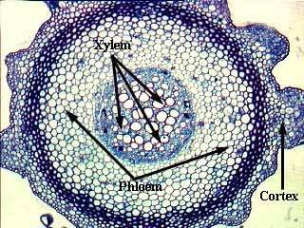
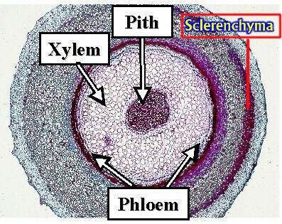
BASIC TYPES OF STELES
PROTOSTELE – Central Xylem, surrounding Phloem. No Pith. Primitive
SIPHONOSTELE – Protostele with Central Pith. Advanced

Slide 3
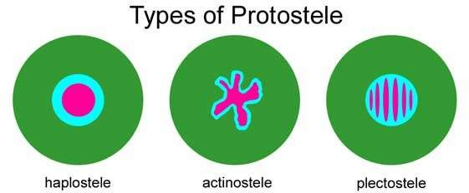
TYPES OF PROTOSTELES
Haplostele – Central circular Xylem. Rhynia
Actinostele – Star shaped Xylem. Ex. Psilotum, Lycopodium serratum
Plectostele- Xylem broken into many parallel plates. Ex. L. clavatum
Mixed Protostele – Small irregular patches of Xylem. Ex. L. cernuum

Slide 4
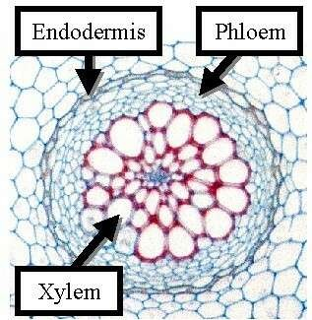
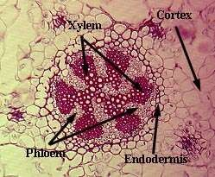
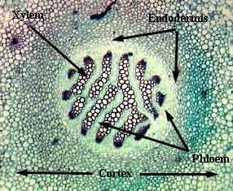

Slide 5
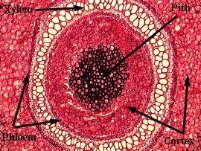
TYPES OF SIPHONOSTELES
Cladosiphonic – No leaf traces
Phyllosiphonic – with leaf traces
Ectophloic – Phloem outside xylem . Ex. Equisetum
Amphiphloic – Outer and inner rings of Phloem, Xylem central. Ex. Marselia

Slide 6
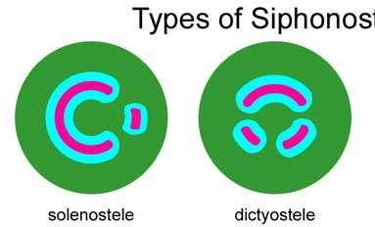
TYPES OF SIPHONOSTELE
Solenostele – Non-overlapping leaf traces. Ex.
Adiantum
Dictyostele- Overlapping leaf traces Ex.
Ophioglossum
Polycyclic – Two or more concentric rings of vascular tissue. Complex type. Ex. Pteris

Slide 7
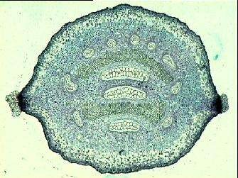
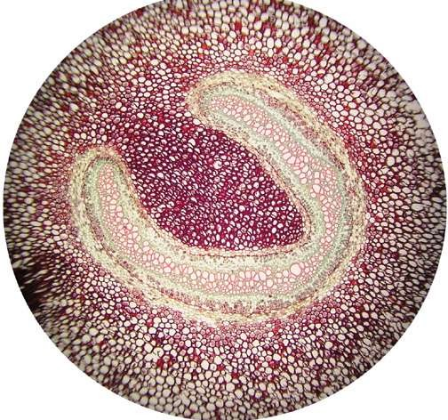
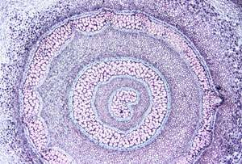

Slide 8
Origin of Siphonostele
Intra stelar Origin – Pith developed from inner xylem cells.
Extra stelar Origin – Pith formed by outer cortical cells which entered inside through leaf gaps.

Slide 9
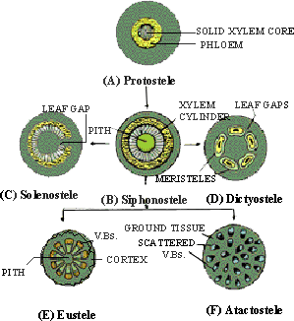
Evolution of Stele

Slide 10
Thank You

