Slide 1
CRASSULACEAN ACID METABOLISM PATHWAY
G.Swapna
Lecturer in Botany

Slide 2
Succulent Plants such a Kalnchoe, Bryophyllum, Sedum belonging to family Crassulaceae forms organic acids at night time
Ex: CAM PLANTS cacatceae,Agavaceae,Orchidaceae,Portulacaceae.
 CAM usually occurs in plants that are found in deserts, arid places, etc.
 CAM pathway is a carbon fixation pathway in some plants. These plants fix carbon during the night, storing it as the four-carbon acid malate.

Slide 3
 It is a carbon fixation pathway present in some plants. Also known as CAM photosynthesis.
 These plants fix carbon dioxide (CO₂) during the night, storing it as the four- carbon acid malate.
 The CO₂ is released during the day, where it is concentrated around the enzyme RuBisCO, increasing the efficiency of photosynthesis.
 The CAM pathway allows stomata to remain shut during the day, reducing transpiration; therefore, it is especially common in plants adapted to arid conditions.
 CAM plants ~> subset of C-4 plants

Slide 4
 The fixation process now occurs in mesophyll cells (found in the leaves) so that they will be more exposed to the air & in order to take in more CO2.
 The malate, which is the product of the fixation process, is pumped deeper in (the leaf) so that it won't be exposed to air and to oxygen.
 This is to avoid photorespiration and the wasteful process, since RuBisCo is used in the Calvin cycle.
 During the day the stomata are closed (thus preventing water loss), and the carbon is released to the Calvin cycle so that photosynthesis may take place.
During Night
 The CAM plant's stomata are open, allowing CO₂ to enter and be fixated as organic acids that are stored in vacuoles. The carbon dioxide is fixed in the mesophyll cell's cytoplasm by a PEP reaction.

Slide 5
 In CAM Plants during night time organic acid content increses,Ph decrease, Sugar content decreaseswhere a sin day time acid decreases,ph increases and sugar content increases.
In CAM Plants leaves are made up of mesophyll
cells contaning chloroplast and vacuoles . There is
no Bundle sheath surrounding vascular bundles as
in c4 plants .
In CAM pathway Both C3 and C4 cycles present
occuring in Mesophyll cells unlike C4 cycle .
Notes:
‹#›

Slide 6
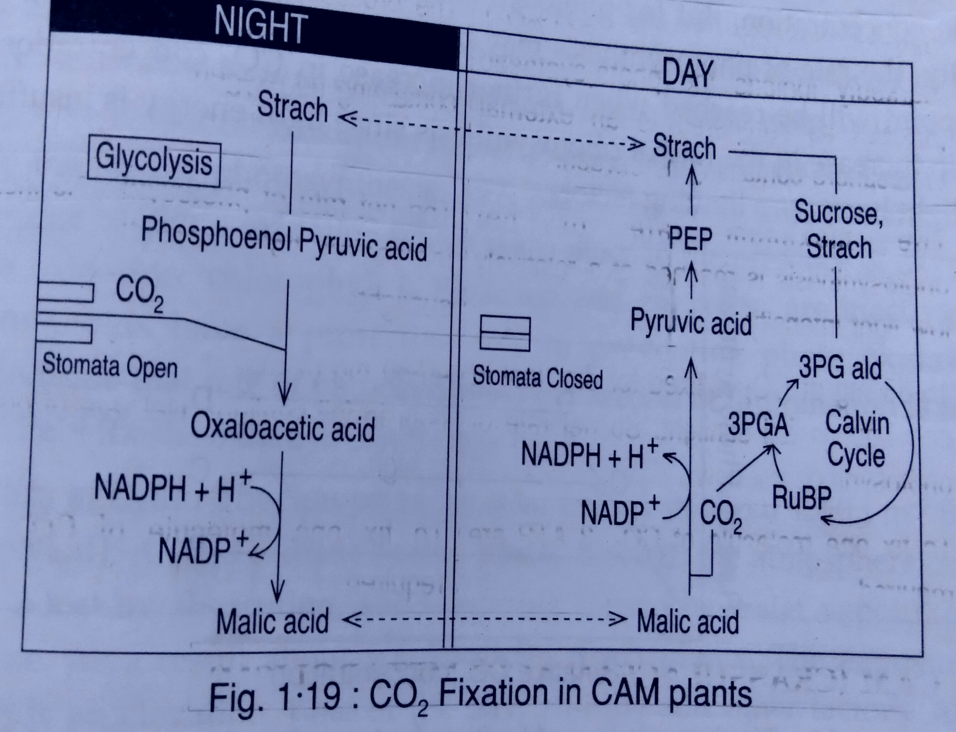

Slide 9
Identifying a CAM plant
 CAM can be considered an adaptation to arid conditions.
 CAM plants often display other xerophytic characters, such as thick, reduced leaves with a low surface-area-to-volume ratio; thick cuticle; and stomata sunken into pits. Some shed their leaves during the dry season; others (the succulents) store water in vacuoles.
 CAM plants not only are good at retaining water but also use nitrogen very efficiently.
 CAM plants can also be recognized as plants whose leaves have an increasing sour taste during the night yet become sweeter-tasting during the day. This is due to malic acid stored in the vacuoles of the plants' cells during the night and then used up during the day.

Slide 10
The benefits of CAM
 The most important benefit to the plant is the ability to leave most leaf stomata closed during the day.
 Being able to keep stomata closed during the hottest and driest part of the day reduces the loss of water
through evapotranspiration, allowing CAM plants to grow in environments that would otherwise be far too dry.

Slide 11
Thank you

