Slide 1
ICBN

Slide 2
Content
Introduction
Principles
Who introduced this
Important Rules of Nomenclature
Subsequent Meeting of IBC
Ranks of taxonomic catgories
Codes of Nomenclature
Typification
Publication
Author Citation
Choice of names
Rejection of names

Slide 3
Introduction
‘The nomenclature involves the principle govern by rules formulated & adopted by International botanical congress , the rules developed by IBC are listed formally in a code called International code of botanical nomenclature’

Slide 4
Principles
Botanical nomenclature is independent of zoology nomenclature
The application of name of taxonomy groups is determined by means of the nomenclature types
The nomenclature taxonomic groups is based upon the priority of the publication
Each taxonomic group with a particular position & rank can only hare one correct scientific name
The scientific name of taxonomic group treated or written in latin language
The rules of nomenclature are retroactive unless expressly limited

Slide 5
Who introduced this
The formal introduction of this system of naming species is credited to Swedish natural Carl Linnaeus , effectively beginning with his work species plantarum in 1753
Linnaeus :- Swedish botanist , physician & zoologist who laid the foundation for the modern biological naming scheme of bionomical nomenclature
He is known as the father of modern taxonomy & is also considered one of the father of modern ecology

Slide 6
Important Rules of Nomenclature
Ranks & ending of taxa
Principle of priority
Type method
Synonyms & related definitions
Citation of author
Name of cultivated plants
Latin diagnosis
Effective & valid publication

Slide 7
Subsequent Meeting of IBC
1892 –Rochester code
1905 –Vienna code
1907 –American code
1910 –Lawrence
1930 –Cambridge congress
1983 –latest I.C.B.N. Sydney Australia
6 Principle
75 Rules
57 Recommendations

Slide 8
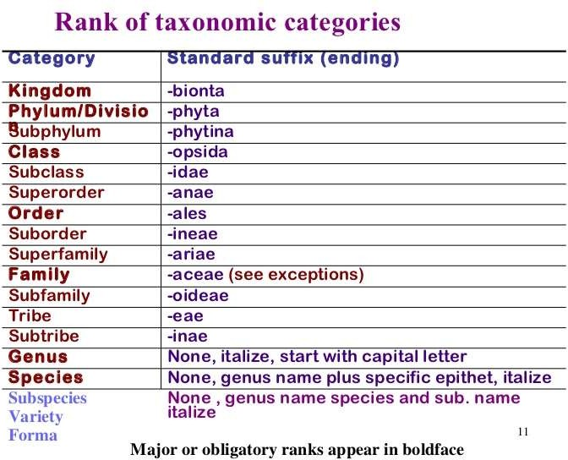

Slide 9
Codes of Nomenclature
International Code of Botanical Nomenclature (ICBN) for plants ( including Fungi & Cyanobacteria )
International Code for Nomenclature of Cultivated Plants ( ICNCP ) only for cultivated plants
International Code of Zoological Nomenclature ( ICZN ) for Animals
International Code of Nomenclature of Bacteria ( ICNB )
International Committee on Taxonomy of Viruses ( ICTV ) for Viruses

Slide 10
Typification
The code has greatly emphasized on typification of taxa in order to bring
about stabilization of names. The naming of taxonomic groups is
determined by means of nomenclature types where a nomenclatural type
is that element , to which the name of a taxon is permanently attached ,
either as a correct name or as a synonym. It is not necessarily the most typical or representative element of the taxon.
1.Holotype 2.Isotype
3.Paratype 4.Syntype 5.Lectotype
6. Neotype 7.Topotype

Slide 11
Publication
Effective Publication – is publication which is accordance with the rules ( i.e. printed matters has to be distributed to the general public or at least to botanical institutions with libraries accessible to botanist generally )
Valid Publication –is a publication that is accordance with the rules I.e.
Have a latin diagnosis or description &
Give a clear indication of rank
Designate a type & its location
Publish in a scientific journal

Slide 12
Author Citation
The name of a taxon ( unitary , binary or ternary ) is incomplete unless the name of the author or authors who first validly published the name
, is cited along the name with it. This helps in verifying the dates of publication and in imparting precision in biological nomenclature.
There are several rules for author citation
Usually the names are cited in abbreviated forms but never underlined , e.g. Vitex Linn
If the name of the plant is jointly published by two authors , their names should be linked by means of et. Or an ampersand ( & )
When more than three author are involved , citation is normally restricted to the first author & is followed by et al.

Slide 13
Choice of names
When the taxon rank is changed , for e.g. , species becomes a genus , the earliest legitimate name in its new rank is its correct name
When two or more taxa of the same rank are united into one , e.g. two or more genera are united , the oldest legitimate name of these taxa should be retained as the name of the united taxon.
When a genus or a species is divided into two or more genera or species , the original name of the genus or species must be retained
When a species is transferred to another genus without the change of rank , the original name must be retained.

Slide 14
Rejection of names
a legitimate name or epithet must not be rejected merely because it is inappropriate or disagreeable , or because another is preferable or better known ,or because it has lost its original meaning. However , a name must be rejected if it was nomenclaturally superfluous when published. Similarly , a name or epithet rejected is replaced by the oldest legitimate name or in a combination by the oldest available epithet in the rank concerned. The following types of name can be considered to be illegitimate & unusable

Slide 15
Reference
www.wkipidia.com
www.google.com
Taxonomy of Angiosperms By-A.V.S.S. Sambamurty
Plant Systematics By- Gurcharan Singh
Advanced plant taxonomy

Slide 16


